Slide 1
Entrepreneurs

Slide 2
What is an entrepreneur?
An entrepreneur is anyone who organises, operates and takes the risk for a new business venture.
Advantages of being an entrepreneur | Disadvantages of being an entrepreneur
Independence – able to choose how to use time and money. | Risk – many new entrepreneurs’ businesses fail, especially if there is poor planning.
Able to put own ideas into practice. | Capital – entrepreneurs will have to put their own money into the business and, possibly, find other sources of capital.
May become famous and successful if the business grows. | Lack of knowledge and experience in starting and operating a business.
May be profitable and the income might be higher than working as an employee for another business. | Opportunity cost – lost income from not being an employee of another business.
Able to make use of personal interests and skills.

Slide 3
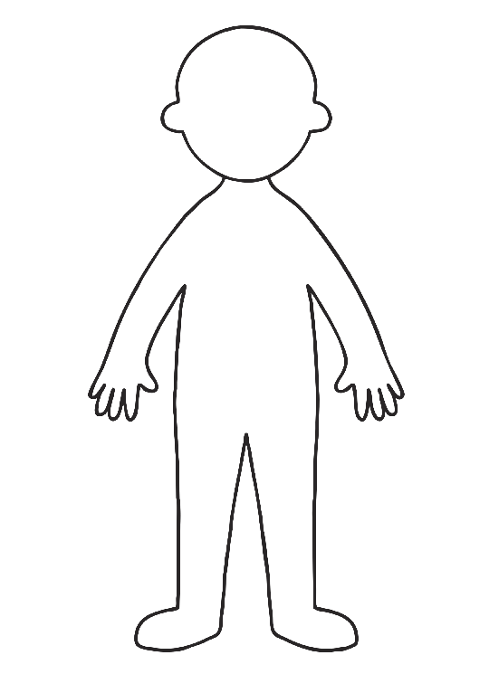
Around your copy of the person write any word you can think of that makes a successful entrepreneur.

Slide 4
Entrepreneurs
Characteristics of successful entrepreneurs | Reasons why they are important
Hard working | Long hours and short holidays are typical for many entrepreneurs to make their business successful.
Risk taker | Making decisions to produce goods and services that people might buy is potentially risky.
Creative | A new business needs new ideas – about products, services, ways of attracting customers – to make it different from other existing firms.
Optimistic | Looking forward to a better future is essential – if you think only of failure you will fail!
Self-confident | Being self-confident is necessary to convince other people of your skills and to convince banks, other lenders and customers that your business is going to be successful.
Innovative | Being able to put new ideas into practice in interesting and different ways is also important.
Independent | Entrepreneurs will often have to work on their own before they can afford to employ others. They must be well motivated and be able to work without any help.
Effective Communicator | Talking clearly and confidently to banks, other lenders, customers and government agencies about the new business will raise the profile of the new business.

Slide 5
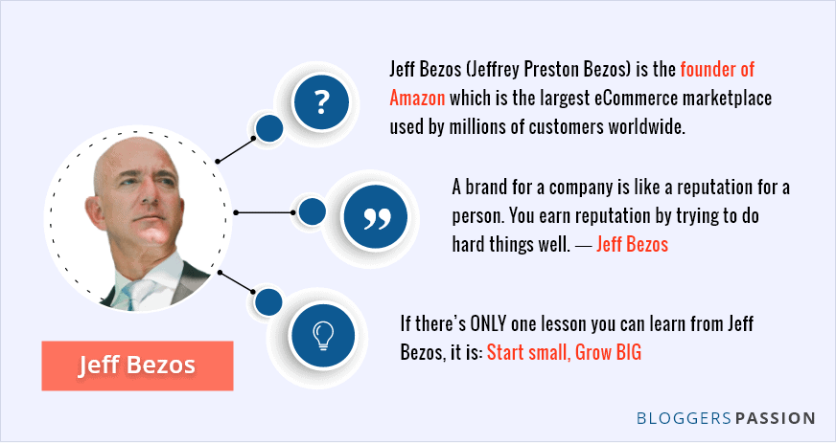
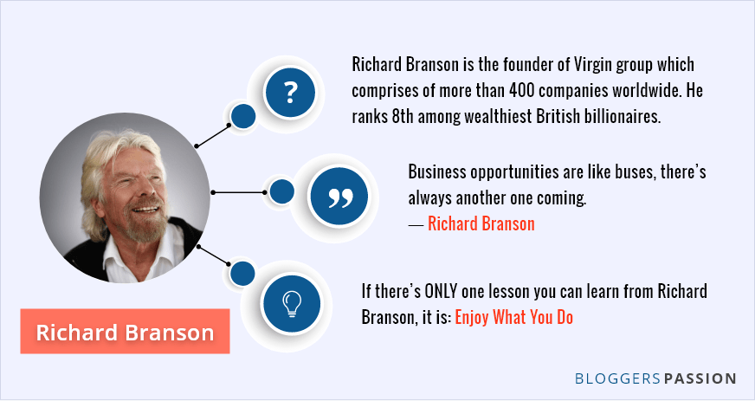
Successful Entrepreneurs

Slide 6
Activity
Explain what it means to be an entrepreneur.

Slide 7
TYPES OF BUSINESS OWNERSHIP

Slide 8
Business organisations
There are seven main forms of business organization:
Sole Trader
Partnership
Private Limited Company (Ltd)
Public Limited Company (Plc)
Co-operative
Franchise
Public Corporation
Copy this list into your books

Slide 9
Liability
An important term we are going to use for the next few lessons is liability.
Liability means responsibility, it considers who is responsible for the debts of the company.
If a company has unlimited liability, it means that the owners of the business are fully responsible for debts of the company. In the eyes of the law, the business and the owner are the same thing. If the company fails, the owner will be responsible for all the debts of the company.
If a company has limited liability, it means that owners of the business are only responsible for their original investment. If the company fails, the owner will only lose what they invested, they do not have to pay the overall debts of the company.
Explain what the term unlimited liability means.

Slide 10
Sole Traders

Slide 11
What is sole trader?
Being a sole trader is the most common form of business organization.
It is a business that is owned and operated but one person – the owner is known as a sole proprietor. They can employ people to work for them, but they are the only owner and take all the risk.
Advantages of being a sole trader | Disadvantage of being a sole trader
There are few legal regulations when setting up the business. | Has nobody to discuss decisions with, they are solely responsible for all decisions.
The owner makes all the decisions! | Has unlimited liability - they are fully responsible for all the debts of the company.
Have the freedom to choose their own working hours, including holidays, etc. | Has limited sources of finance.
There is often close contact with customers. | The business is likely to remain small.
Can complete all information completely private, do not have to share with anyone except the tax office. | They generally work on their own so it can be difficult to take time off for holidays or if you are ill.
The owner keeps all the profits!

Slide 12
Partnerships

Slide 13
What is a partnership?
A partnership is when between 2 and 20 people own a business together. The division of the company does not have to be equal.
Investment in the business and the profits of the business are shared among the partners.
Advantages of being in a partnership | Disadvantages of being in a partnership
There is more access to capital that can be invested in the company. | They have unlimited liability.
The responsibilities of the business are shared. | Partners may disagree which could lead to arguments.
Partners can specialize in different areas which means they business may run more efficiently. | Profits have to be shared.
 | Although there is more capital available than a sole trader, there is still a limit to how much can be invested.

Slide 14
What is a Deed of Partnership?
A Deed of Partnership is a legally binding document drawn up by partners. If a conflict arises between the partners, they can refer to the Deed of Partnership (also called a Partnership Agreement).
A Deed of Partnership will normally cover areas like:
The finance provided by each partner.
The salary entitlements.
The percentage of profit to be received by each partner.
Holiday entitlements.
The registered address.
The roles of each partner.
Any other area that may cause dispute.

Slide 15
Activity
1. Explain what it means to be a sole trader and what it means to be a partnership.
2. Draw your own revision summary showing the advantages and disadvantages of being a sole trader and in a partnership.

Slide 16
Plenary
I will give you the answer – what is the question???

Slide 17
One owner

Slide 18
Can be difficult to find finance.
Has unlimited liablity.

Slide 19
Get to keep all the profits.
Make all the decisions.

Slide 20
The owner and the business are the same in the eyes of the law.

Slide 21
Has between 2 and 20 owners.

Slide 22
Can share work load.
More access to finance.

Slide 23
Both partners have unlimited liability.

Slide 24
More potential for arguments.
Unlimited liability.

Slide 25
Deed of Partnership.

