Slide 1
Stakeholders and Objectives

Slide 2
As we work through the slides. Take notes on each of the topics.
You will be given some additional notes at the end of the topic.

Slide 3
Stakeholders
The following groups are involved in business activity, either directly or are affected by it:
Owners
Consumers
Workers
Governments
Managers
Banks
The Community
The groups are called stakeholders.
Some are internal stakeholders, e.g. owners, and some are external stakeholders, e.g. the community.

Slide 4
Objectives
An objective is an aim or target to work towards. All businesses should have objectives, They help to make a business successful – although setting an objective does not ‘guarantee success’!
The benefits of setting objectives are:
The give workers and managers a clear target to work towards and this helps motivates people.
Taking decisions will be focused on: ‘Will it help achieve our objectives?’
Clear and measurable objectives help unite the whole business towards the same goal.
Business managers can compare how the business has performed with their objectives – to see if they have been successful or not.

Slide 5
Objectives
There are six main business objectives:
Business survival
Profit
Returns to shareholders
Growth of the business
Market share
Service to the community

Slide 6
Survival
Approximately 1/3 of new businesses fail.
When a business first starts, they will be more concerned with survival than anything else. Businesses will do things that will help to make sure that customers want to come to them and then stay with them.

Slide 7
Profit
Profit
= total income of the business (sales revenue) – total costs
When a business is owned by private individuals rather than the government it is a usually the case that the business is operated with the aim of making a profit. The owners will each take a share of these profits. Profits are needed to:
Pay a return to the owners of the business for the capital invested and the risk taken.
Provide finance for further investment to the business.
Without any profit the owners are likely to close the business.

Slide 8
Returns to shareholders
Shareholders are the owners of limited companies – those that sells shares. The managers of companies will often set the objective of ‘increasing returns to shareholders’. This means to make more profit to give back to the shareholders.
Returns to shareholders are increased in two ways:
Increasing profit and the share of profit paid to shareholders as dividends.
Increasing share price – manager can try to achieve this not just by making profits but by putting plans in place that give the business a good chance of growth and higher profits in the future.

Slide 9
Growth
The owners and managers of a business may aim for growth in he size of the business – usually measured by value of sales or output – for a number of reasons:
To make the jobs more secure if the business is larger.
To increased the salaries and status of managers as the business expands.
To open up new possibilities and help to spread the risks of the business by moving into new products and new markets.
To obtain a higher market share from growth in sales.
To obtain cost advantages, called economies of scale, from business expansion.
Growth will only be achieved if the businesses customers are satisfied with the products and services being provided. For this reason it might be important to put meeting customers’ needs as a very high priority.

Slide 10
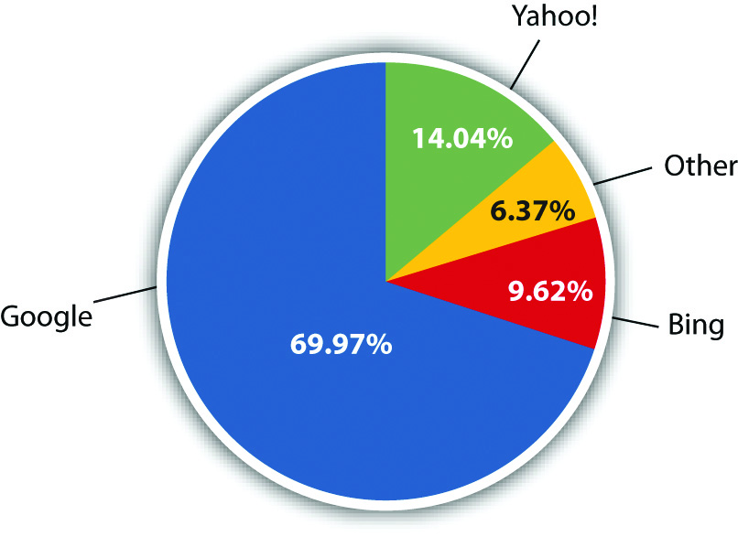
Market Share
If the total value of sales in a market is $100 million in one year and Company A sold $20 million, then Company A’s market share is 20%
Market share % = Company sales
Total market sales x 100
Increased market share gives a business:
Good publicity, as they could claim they are becoming the ‘most popular’.
Increased influence over suppliers, as they will be very keen to sell to a business that is becoming relatively larger than others in the industry.
Increased influence over customers (for example, in setting prices).
This Photo by Unknown Author is licensed under CC BY-SA-NC

Slide 11
Providing a service to society
Social enterprises are operated by private individuals – they are in the private sector – but they do not just have profit as an objective. The people operating in the social enterprise often set three objectives for their business:
Social: to provide jobs and support for disadvantaged groups in society, such as the homeless.
Environmental: to protect the environment.
Financial: to make a profit to invest back into the social enterprise to expand the social work that it performs.
Examples of social enterprises include;
TOMS Shoes who donate a pair of shoes to a child in need for every pair they sell.
Baron Fig who produce high quality notebooks and plant a tree for every notebook sold.
734 Coffee who support Sudanese refugees by working with local farmers and providing market for their goods.

Slide 12
Activity 1
Here are brief details of four businesses.
A small firm of builders which has noticed new businesses being set up in the building industry.
A recently established business in the rapidly expanding computer industry, which is owned by two young and ambitious entrepreneurs.
A large book publishers which dominates the market in textbooks in your country.
A group of people who are concerned about the lack of clean water provided to poor communities.
Identify and explain the most likely objective of the managers to each of these businesses.
In each example, explain the decisions that could help the businesses to achieve these objectives.

Slide 13
Why business objectives could change.
It is most unusual for a business to have the objective forever! Here are some examples of situations in which a business might change its objectives.
A business set up recently has survived for three years and the owner now aims to work towards higher profit.
A business has achieved higher market share and now has the objective of earning higher returns for shareholders.
A profit-making business operates in a country facing a serious economic recession so no has the short term objective of survival.

Slide 14
Conflict of Stakeholders Objectives
It is sometimes assumed that businesses can set one objectives and only change because they want to, but most businesses are trying to satisfy the objectives of more than one group.
Managers therefore have to compromise when they come to decide on the best objectives for the business they are running. They would be unwise to ignore the real worries or aims of other groups with an in interest in the operation of the business. Managers will also have to be prepared to change the objectives over time. Growth could be the best option during a period of expansion in the economy, but survival by cost cutting might be better if the economy is in recession.

Slide 15
Copy this diagram:
Activity
profits
return on capital
salaries
status
control
incomes
job security
satisfying work
owners
managers
workers
BUSINESS STAKEHOLDERS
customers
community
government
goods and services
quality
good value
jobs
clean environment
safe products
employment
taxes
increasing national output

