Slide 1
Other Business Organisations

Slide 2
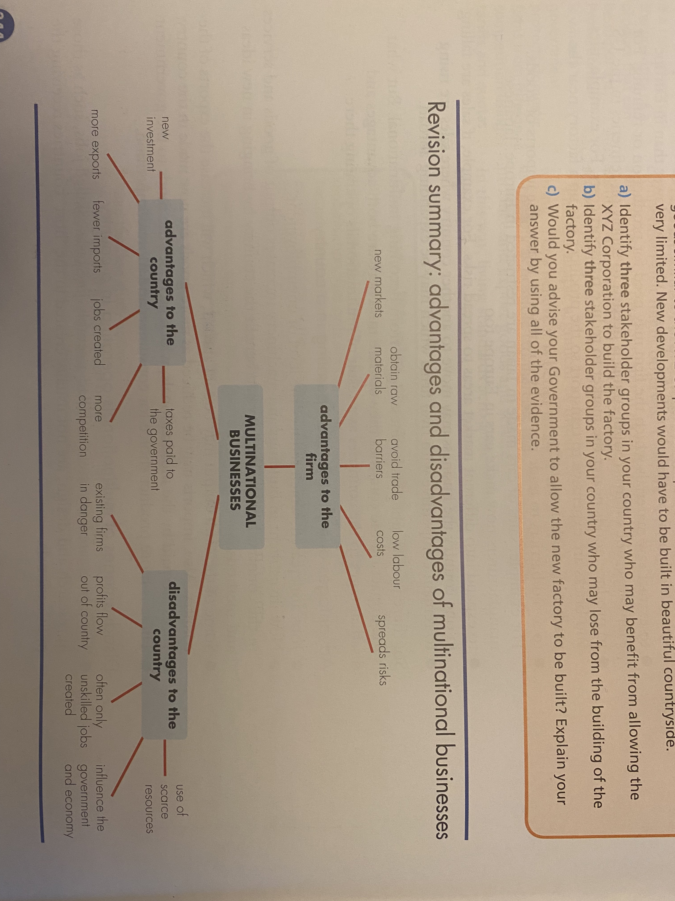
Multinationals
A multinational business is one that has factories, production or service operations in more than one country. These are sometimes known as transnational businesses.
In your books, define the term multinational business.
Copy the advantages and disadvantages of multinational organisations.

Slide 3
Should we allow the XYZ Corporation to set up a factory in our country?
The XYZ Corporation is applying for planning permission to build a factory in your country. The factory is expected to be very profitable. One thousand new jobs should be created for assembly-line work. Many of the goods made could be sold abroad. Some of the supplies for the for the factory will come from your country.
In your country unemployment is high, especially amongst skilled workers. The Government cannot afford any new building projects. There are several local competitors producing goods similar to the XYZ Corporation. Import levels are very high. Land for new building is very limited. New developments would have to be built in beautiful countryside.
Identify three stakeholder groups in your country who may benefit from allowing the XYZ Corporation to build the factory.
Identify three stakeholder groups in your country who may lose from the building of the factory.
Would you advise your Government to allow the new factory to be built? Explain your answer by using all of the evidence.

Slide 4
Co-operatives
A co-operative is a group of people pursuing the same economic, social and cultural goals through a democratically controlled enterprise. Co-ops are the original people’s business – set up by the people for the people.
Co-ops are owned and controlled by their members, which makes them very different to other businesses. Instead of answering to shareholders or the bank, co-ops are accountable to their members. Every co-op has a committee made up of members. The may form a workers’, consumers’ or producers’ co-operative:
In a workers’ co-operative, the business is owned and controlled by the workers. Each member has one vote and puts in an equal amount of capital. Risk of failure and success can then be equally shared.
A consumers’ co-operative is usually formed where a group of consumers want to buy together in bulk to gain cheaper prices. In this way, they are able to share equally any gains that they make.
A producers’ co-operative occurs where producers join together either to create their own market or to take advantage of joint marketing or joint purchasing of expensive items of equipment.

Slide 5
Advantages and disadvantages of co-operatives
Advantages of co-operatives | Disadvantages of co-operatives
Every member is a shareholder and therefore is committed to the success of the business. | Democractic decision making can be slow and frustrating for members.
Members are able to set their own terms and conditions for the business including pay. | Members may disagree.
Members control all elements of the business, including recruitment, pricing and production. | Customers and members of the business and finance community may see co-operatives as low status.
The co-operative can benefit from the range of ideas and experience brought by its members. | Not everyone may have the same commitment to the co-operative.
 | The committee that controls the co-operative may lack business experience.

Slide 6
Task
Explain the term co-operative.
Draw a spider diagram of the advantages and disadvantages of being a co-operative.

Slide 7
Joint venture
A joint venture is when two or more businesses agree to start a new project together, sharing the capital, the risks and the profits.
For example, many European businesses have set up joint ventures in China with Chinese businesses, as the local managers will have good knowledge of market needs and consumer tastes.
Advantages of joint ventures | Disadvantages of joint venture
Sharing of costs – very important for expensive projects such as new aircraft. | If the new project is successful, then the profits have to be shared with the joint venture partner.
Local knowledge when joint venture company is already based in the country. | Disagreements over important decisions might occur.
Risks are shared. | The two joint venture partners might have different ways of running a business – different cultures.

Slide 8
Task
Explain the term joint venture.
Draw a spider diagram of the advantages and disadvantages of being a joint venture.

Slide 9
Public vs private sector

Slide 10
A market is where a seller and a customer come together to perform business activity.
Often, the government will influence the market by creating rules and laws that structure the way in which buyers and sellers meet and interact. The government can do this by:
Imposing a ban on certain products, so there is no market for them
Putting a tax on certain goods and services to limit their supply and demand, for example, cigarettes
Supplying them itself, for example, governments often supply medical care so that everyone has an equal chance of using it.
The amount of government involvement in an economy will determine what type of economy a country has.

Slide 11
(Free) market economy
Mixed
economy
Planned/command
economy
(Free) market economy
Here the government has no role at all. It is the buyers and sellers who determine the price and make trading decisions. There are very few totally free market decisions.
Mixed economy
Here the buyers, sellers and government all have influence. This type of economy is common in nearly all countries.
Planned/
command economy
Here the government has total control. They make all decisions regarding price and trading decisions. This is very rare and becoming rarer!

Slide 12
The private and public sectors
The public sector
Businesses that are in the public sector are government or state owned and controlled organisations. The government, or other public authority, makes decisions about what to produce and how much to charge consumers. Some goods and services are provided free of charge to the consumer, such as state health and education services. The money for these comes not from the user but from the taxpayer.
The private sector
Businesses that are not owned by the government are in the private sector. These businesses will make their own decisions about what to produce, how it should be produced and what price should be charges for it. Most businesses in the private sector will aim to run profitably. Even so, there are likely to be some government controls over these decisions.
Objectives of private-sector and public-sector businesses are often different.

Slide 13
Mixed Economies
In recent years, many governments have changed their balance between the private sector and public sector in their economies. They have done this by selling some public sector businesses to the private sector. This is called privatization. In many European and Asian countries the water supply, electricity supply and public transportation systems have been privatized.
It is often claimed that private sector businesses are more efficient that public sector businesses. This is because their main objective is profit and therefore costs must be controlled. Also private sector owners might invest more capital in the business than the government can afford. Competition between private sector business can help to improve product quality.
However, a business in the private sector might make more workers unemployed than a public sector business in order to cut costs. A private sector business is also less likely to focus on social objectives.

Slide 14
Public Corporations
The last type of organization is a public corporation. These are wholly owned by the state or central government. They are usually businesses which have been nationalized. This means they were once owned by private individuals, but were purchased by the government.
Public corporations are owned by the government but it does not directly operate the businesses. Government ministers appoint a Board of Directors, who will be given the responsibility of managing the business. The government will, however, make clear what the objectives of the business should be. The directors are expected to run the corporation according to these objectives.

Slide 15
Advantages of public corporations | Disadvantages of public corporations
Some industries are considered to be essential to the population so the government wants to make sure they are provided. | There are no private shareholders to insist on high profits and efficiency.
A natural monopoly is often owned by the government to make sure that the public are not taken advantage of. | Government subsidies (money given by the government) can lead to inefficiency as the managers will think money will also be available. Also, subsidies can be seen as unfair to private sector businesses.
The government will take/keep ownership of an industry to stop it failing and keep it open and secure jobs. | Often there is no close competition for public corporations, again leading to the chance of inefficiency.
Important public services, such as TV and radio, are often public sector so non-profitable services can be made available to the public. | Governments can use public corporations for political reasons.
Explain what a public corporation is and why they may be necessary to a country.

