Slide 1
Recruitment

Slide 2
Recruitment
Recruitment Process
Recruitment is the process of filling an empty role within an organization. It ranges from the identification of the vacancy to the training of the person given the job.

Slide 3
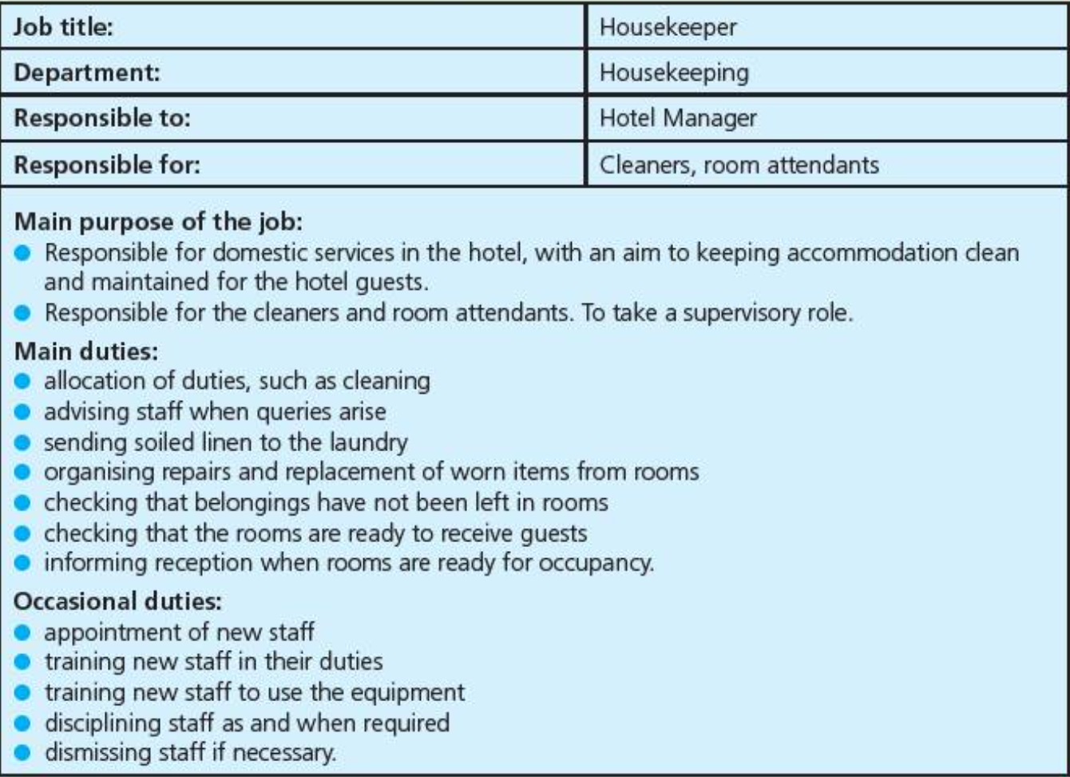
Job Description
A job description is document that outlines the duties of the role, it does not give any information about the type of person that will be needed.

Slide 4
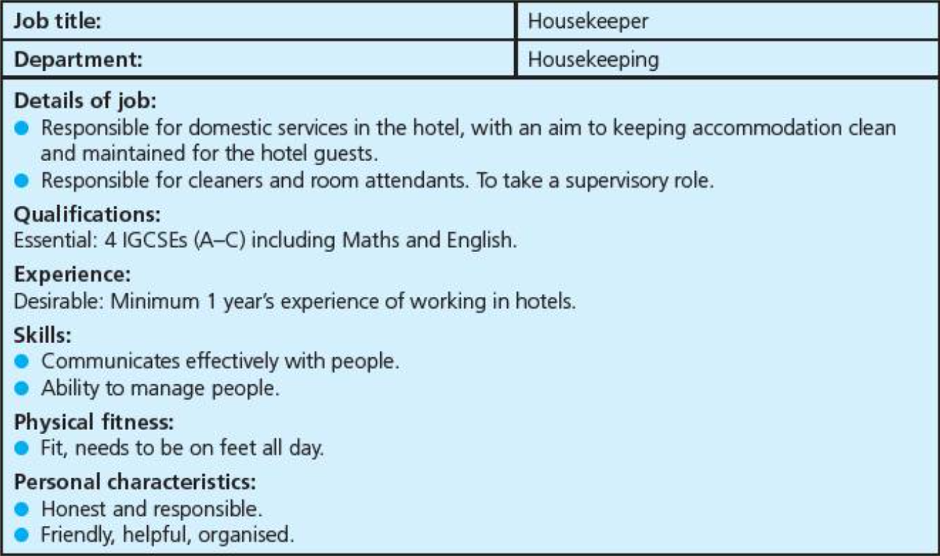
Job Specification
A job specification is a document that lists the qualifications, skills, expertise, physical characteristics of the person who is needed to fulfil the job.

Slide 5
Internal Recruitment
Internal recruitment takes place when someone who is already in the business is given a new role.
Advantqges:
It saves time and money as you do not need to find someone new.
The person is already known to the company so their reliability, personality and ability are known.
The person already knows the organization so won’t take as long to get used to the new role.
It can be motivating to promote a current employee.
Disadvantages:
There are no new ideas or experiences in the business.
It may create jealousy with workers that didn’t get the job.

Slide 6
External Recruitment
External recruitment is when a new person is brought into the organization to fill the job vacancy.
The advantages and disadvantages are the opposite as for internal recruitment.
There are lots of places that jobs can be advertised:
Websites
Local newspapers
National newspapers
Specialist magazines and journals
Recruitment agencies
Government run agencies (called Job Centres in the UK)
The type of job will determine where it is advertised.

Slide 7
Job advertisements should include:
The name and address of the company (so that the applicant knows where to respond to)
The job title
A summary of the job
Salary information
Anything else the company wants the applicant to know before they apply
Job Advertisements

Slide 8
Applying for a job
There is no one right way to apply for a job. Each company will ask for something different. However, most companies will expect you to either write a letter applying for the job or to fill in an application form. They will also want you to have a resume (this is called a C.V. – Curriculum Vitae – in the UK).
These documents will be used to evaluate candidates to see who they would like to find more about.
There are lots of examples of application letters online and we will be writing our own. We are also going to write a very basic resume for you. It is likely that you will upgrade these when you actually apply for a job but it will be a start!

Slide 9
Resume/C.V.
A resume is a document that gives a summary of your personal details.
It lists all the factual information a potential employer could need.
It also includes the names and contact details of the people the potential employer should contact to find out a little more about you.
Below is some advice on writing a resume.
https://www.monster.co.uk/career-advice/article/cv-tips
(Show in brower)

Slide 10
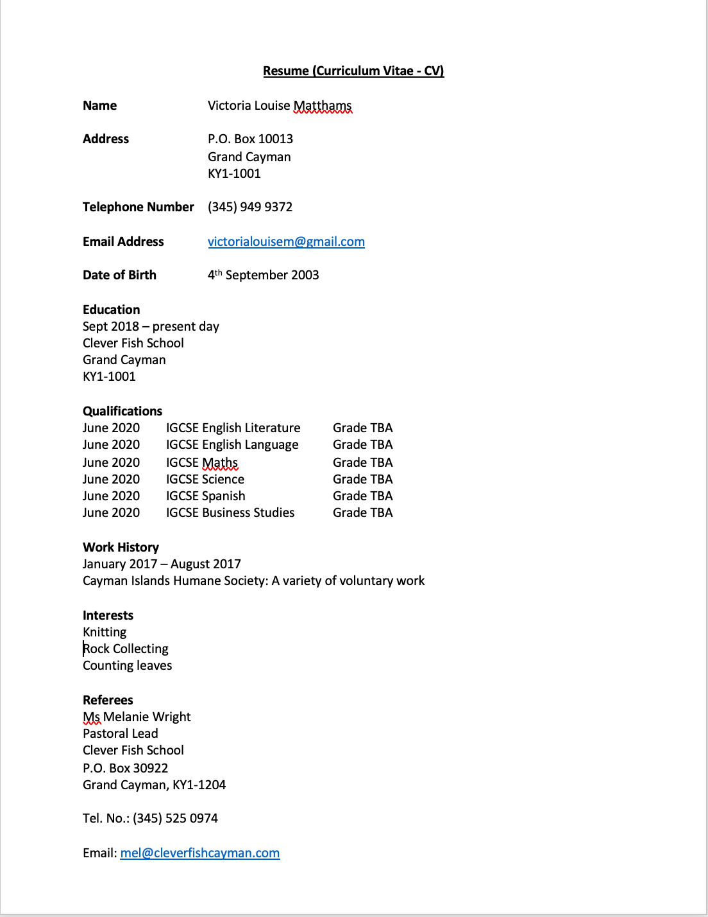
Example of Resume

Slide 11
Application Letter
An application letter or email is a way to introduce your self to the company. It is important to send something, even if the company asks for an application form.
There are lots of tips and advice online on how to write an application letter.
Below is an article on what to include.
https://career-advice.jobs.ac.uk/cv-and-cover-letter-advice/cover-letters/top-ten-tips-for-writing-cover-letters-2/
(show in browser)

Slide 12
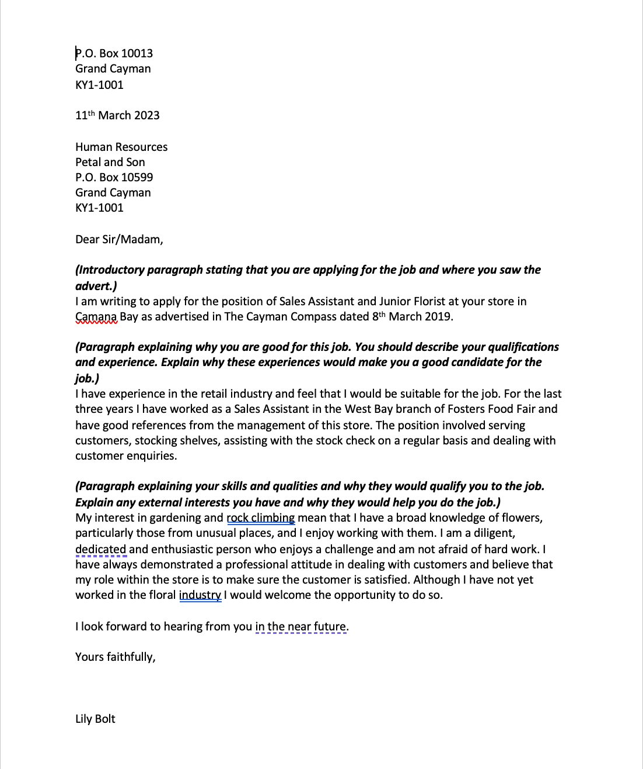
Example of Application Letter

Slide 13
Interviews
Applicants that the company is interested in are shortlisted and invited for interview. This can be in person, or online. It is often easier to get an idea of whether or not the person will be a good fit for the role and the organization if you meet them in person.
At this point, companies will also check the person’s references. These are people who the applicant has asked to give their opinion on the person. You must always ask someone before giving their name as a referee for you. If you are at school, or have just left school, you will normally give the name of a teacher, if you are older, it will normally be your last employer.
An interview is basically a conversation between the company and the applicant. There are lots of tips online and we are going to practice some interview technique.

Slide 16
