Slide 1
Franchises

Slide 2
As we have seen, it can be very risky for somebody to set up as a sole trader or a partnership. One way of minimizing some of this risk is to buy into a franchise agreement.
A franchise is a business based on the use of the brand names, promotional logos and trading methods of an existing successful business.
The franchisee buys the licence to operate this business from the franchisor. Each year the franchisee pays a fee to the franchisor, called a royalty payment. This is a percentage of the profit.

Slide 3
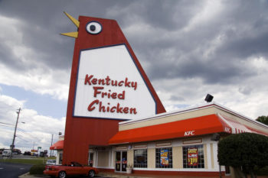
Franchisee
Contributes:
Capital
Enterprise
Management
Franchisor
Contributes:
Original idea
Use of brand
name and
products
Advertising and training

Slide 4
Advantages and disadvantages of being in a franchise
 | To the franchisor | To the franchisee
Advantages | The franchisee buys a licence from the franchisor to use the brand name. Expansion of the franchised business is much faster than if the franchisor had to finance all new outlets. The management of the outlets is the responsibility of the franchisee. All products sold must be obtained from the franchisor. | The chances of business failure are much reduced because a well-known product is being sold. The franchisor pays for advertising. All supplies are obtained from a central source – the franchisor. There are fewer decisions to make than with an independent business – prices, store layout and range of products will have been decided by the franchisor. Training for staff and management is provided by the franchisor. Banks are often willing to lend to franchisees due to relatively low risk.
Disadvantages | Poor management of one franchised outlet could lead to a bad reputation for the whole business. The franchisee keeps profits from the outlet. | Less independence than with operating a non-franchised business. May be unable to make decisions that would suit the local area – e.g. new products that are not part of the range offered by the franchisor. Licence fee must be paid to the franchisor and possibly a percentage of the annual turnover.

Slide 5
Task
Investigate a franchise of your choosing. You can use the following website to help find a franchise if you don’t know of any:
www.franchisedirect.co.uk/top-100-franchises-uk-2019
However, if you know of another one, you can choose it.
You need to find out:
The history of the company.
How you can become a franchisee.
Where the franchises are located.
What fees are involved for the franchisee.
You will need to report your findings to the rest of the class.

