Slide 1
Limited Companies

Slide 2
Unlike a sole trader or a partnership, a limited company is a separate legal unit from its owners – they are incorporated businesses. This means that:
a company exists separately from the owners and will continue to exist if one of the owners should die
a company can make contracts or legal agreements
company accounts are kept separate from the accounts of the owners.
As companies have their own legal identity, their ownership is allocated by issuing shares. Shareholders invest money in the organization and, in return, they own a part of the business called a share. The number of shares that a shareholder has determines how much of the business they own. How shares are bought and issued depends on the type of company.

Slide 3
Private Limited Companies
A Private Limited Company (Ltd) can sell shares privately; that is, usually to family, friends and employees. It may not publicly advertise the sale of the shares, and any shareholder has to be approved by directors.
A private limited company must display Ltd after its name making it clear to anyone dealing with it that its liability is limited.
The shareholders appoint directors to run the business. In a private limited company, the directors are usually the most important or majority shareholders. This is usually not the case in a public limited company.
The reward for owning shares for a shareholder is dividends. This is a share of the profits and is dependent on the number of shares the shareholder owns.

Slide 4
Private Limited Companies (Ltd) issues their shares to private investors who they choose, which mean that the ownership of the business is kept private.
In order to set up, they have to prepare two documents:
The articles of association (the legal document detailing the responsibilities of the internal members).
The memorandum of association (the legal document detailing the registered name, address and share structure).
In addition, the law requires private limited companies to hold an AGM (annual general meeting), a yearly meeting with shareholders and directors – Public Limited Companies (Plc) have to hold these too.

Slide 5
Advantages and disadvantages of an Ltd.
Advantages | Disadvantages
Shareholders have limited liability. | Annual accounts have to be published.
Additional capital can be raised by selling more shares. | Shares cannot be sold to the general public, therefore, the business cannot raise really large sums of money.
The business can continue even if one of the shareholders leaves or dies. | There are legal restrictions when setting up, i.e. the documentation it must produce.
Shareholders have to be approved by the directors, so the original owners can maintain more control. | Directors make the decisions so the original owners may not have as much influence
Private limited companies are often large enough to have directors who specialize in a particular area | It is more expensive and complicated to set up than a sole trader or a partnership.

Slide 6
Public Limited Companies
A Public limited company (Plc) is a form of organization only suitable for very large businesses. It can invite the general public to purchase its shares and there is no limit to the number of shareholders a public limited company can have. Shares in public limited companies are quoted on the stock market.
When a company wants to become a public limited company they have to apply, this process is very expensive and is called flotation.
Common mistake!!!
Public limited companies are not in the public sector of industry. They are owned by private individuals NOT the government.

Slide 7
Advantages and disadvantages of a Plc.
Advantages | Disadvantages
Shareholders have limited liability. | Annual accounts have to be published.
Very large amounts of capital can be raised by selling more shares. | The legal formalities of setting up public limited companies are very complicated.
There is no restriction on the number of shares sold. | It is very expensive to float a company on the stock market.
They are generally seen as very high status organisations. | As shares can be sold to anyone, the original owners can lose control when the business ‘goes public’.

Slide 8
Control and ownership in a Plc
Shareholders
may attend AGM (few do!)
Ownership
vote for Board of Directors who take all important decisions
Control
appoint managers for day-to-day business decisions

Slide 9
Risk, ownership and limited liability – summary
Business organisation | Risk | Ownership | Limited Liability
Sole Trader | Carried by sole owner | One person | No
Partnership | Carried by all partners | 2 – 20 partners | No
Private Limited Company | Shareholders up to their original investment | Shareholders – may be few or many but shares cannot be sold to the public | Yes
Public Limited Company | Shareholders up to their original investment | Shareholders – many (may be millions!) | Yes

Slide 10
Key Terms
The limited companies topic has lots of specialized terminology and it is important to learn these words.
Key Terms
Incorporated businesses | Companies that have separate legal status from their owners.
Shareholders | The owners of a limited company. They buy shares which represent part ownership of a business.
Private Limited Company (Ltd) | A business owned by shareholders invited to buy shares.
Public Limited Company (Plc) | A business owned by shareholders. Shares are sold on the stock market to anyone.
Annual General Meeting (AGM) | This is a legal requirement for all companies. Shareholders may attend and vote on who they want to be on the Board of Directors for the coming year.
Dividends | Payments made to shareholders from the profits (after tax) of a company. They are the return to shareholders for investing in the organization.

Slide 11
Task
Certificate of
Incorporation
Multinational
Company whose shares are traded on the stock market
The return to the shareholder of a company
Part-ownership of a company
Organization which operates and trades in a number of different countries
Company controlled by individuals and restricted groups
Document confirming that an organization has company status
Document enabling a Plc to commerce trading
Document setting out the internal rules and relationships of an organization
Document setting out the external rules and relationships of an organization
Articles of
Association
Memorandum of
Association
Share
Dividend
Certificate of
Trading
Private Limited Company
(Ltd)
PLC

Slide 12
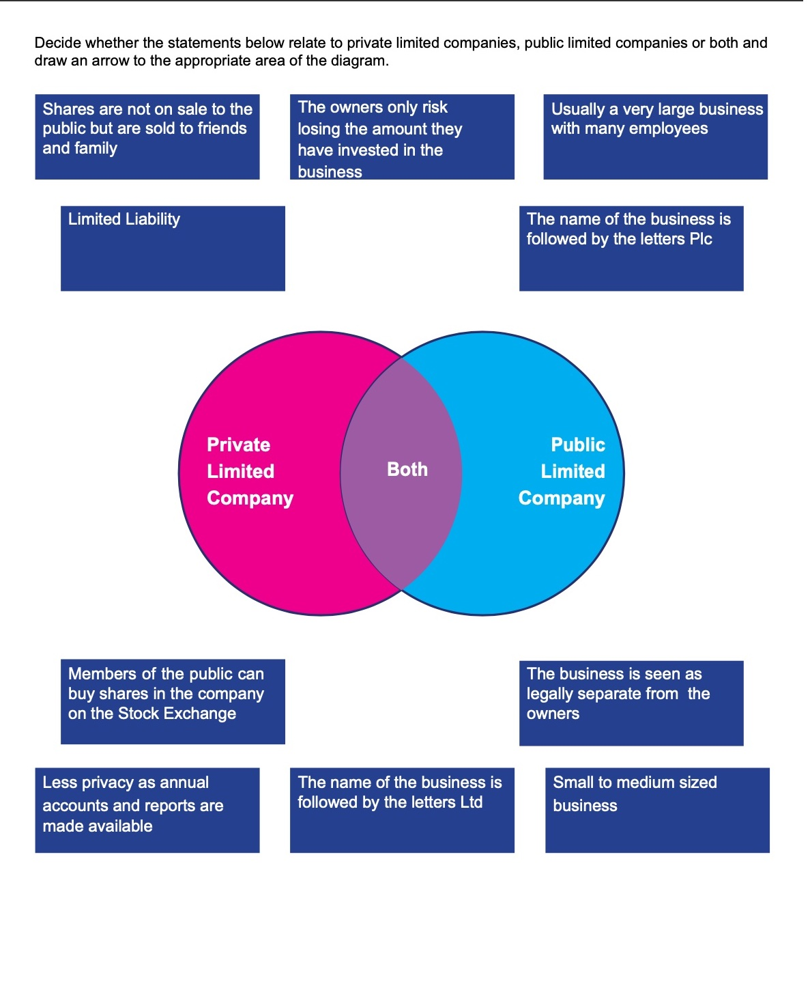

Slide 13
Answer the following questions:
Aurelie and Nadine set up the A and N Partnership ten years ago. It specializes in handmade shoes and boots. The business now employs around 20 people. Demand for these products is increasing rapidly. The partners need to invest much more capital in the business but they need to avoid a lot of risk as they both have families dependent on the income made from the business. Their main competitor is ShoeWorks plc, which has a much larger market share than A and N can can afford extensive advertising.
a) What is meant by ‘partnership’?
(2 marks)
b) Identify two benefits to Aurelie and Nadine of the partnership legal structure.
(2 marks)
c) Identify and explain two possible benefits to ShoeWorks plc of being a public limited company.
(4 marks)
d) Identify and explain two drawbacks of the partnership form legal structure to Aurelie and Nadine.
(6 marks)
e) If the A and N partnership business continues, recommend whether a private limited company is a suitable form of legal structure for this business. Justify your answer by considering the advantages and disadvantages of a private limited company.
(6 marks)

Slide 14
How do stocks and shares work?

