Slide 1
Leadership Styles

Slide 2
What does it mean to be a good leader?
On the mini white boards, write down all the characteristics you think you need to be a good leader.
What is the most important characteristic?

Slide 3
An effective leader is essential for a successful business. They are someone who can inspire others and get the best out of the workforce. They get everyone to work towards a common goal.
Leadership styles are the different approaches to dealing with people when in a position of authority.
There are three main leadership styles you need to learn:
Autocratic
Democratic
Laissez-faire

Slide 4
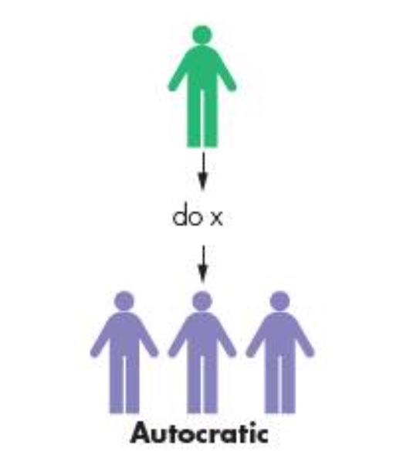
Autocratic Leadership
Autocratic leadership is where the manager expects to be charge of the business and to have their orders followed. The keep themselves separate from the rest of the employees. The make virtually all the decisions and keep information to themselves. They tell employees only what they need to know. Communication in the business is mainly one way, that is, downward or top-down, and the workers have little or no opportunity to comment on anything.

Slide 5
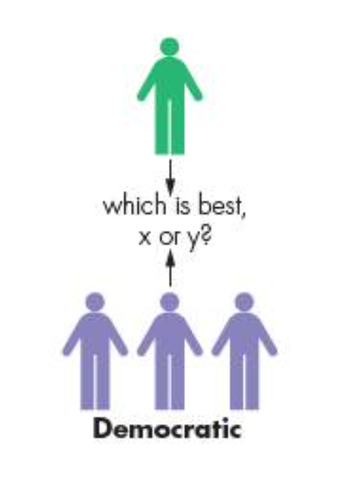
Democratic Leadership
Democratic leadership will get other employees involved in the decision making process. Information about future plans will be openly discussed before the final decision will be made, often by the leader. Communication will be both downward or top-down and upward or bottom-up.

Slide 6
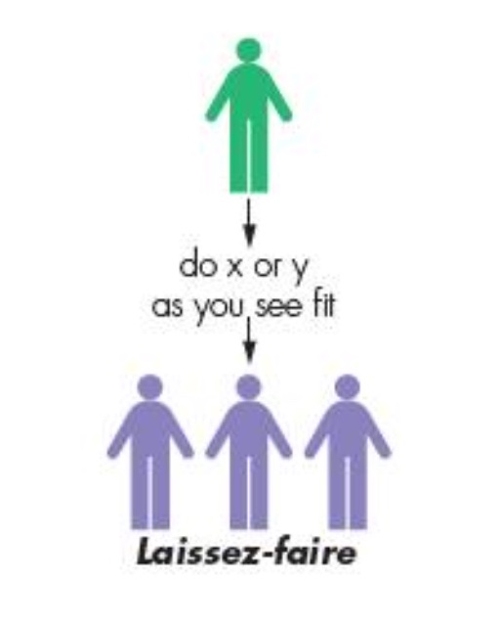
Laissez-faire Leadership
Laissez-faire is French for ‘leave to do’. Laissez-faire leadership tends to make the broad objectives of the business known to employees, but then they are left to make their own decisions and organize their own work. Communication can be difficult in this type of organization as clear direction will not be given. The leader has only a very limited role to play.

Slide 7
The style of leadership used by a manager can vary depending on the employees being dealt with at the time and the problem to be solved. Managers may not be autocratic leaders all of the time – it may be appropriate for them to be democratic over some issues, whereas other issues will need a decision imposing on the workforce.
Task:
Write a definition of each of the leadership styles and explain a situation in which in may be appropriate to use each type of leadership style.

