Slide 1
Motivation Theorists

Slide 2
F.W. Taylor
F.W. Taylor was one of the original motivation theorists. He worked as an engineer in observed productivity in the labourers in his factory.
He observed that all workers are motivated by personal gain, therefore, if they are paid more they will produce more.
He broke down their jobs into simple processes and then calculated how much output they should be able to do in a day. If they produced more than this target they were paid a bonus. Therefore, his workers were motivated to produce more (i.e. work harder) as they were going to be paid more money.
Problems with Taylors work:
The ideas are too simplistic – workers are motivated by man things.
If a worker is unfulfilled in their work, they are unlikely to be motivated by just more money.
It can be difficult to measure a workers output in some jobs.

Slide 3
Discussion Task:
Form the following list of jobs, say what you could measure to find out how effectively the employees are working (how much output they are producing):
Car production worker
Shop assistant
Waiter
Teacher
Police Officer
Soldier
Baker
Are there any jobs from the list for which output is difficult to measure? Why is it difficult to measure?
If you cannot measure workers’ output, how can you pay them more money if they work harder or more effectively?

Slide 4
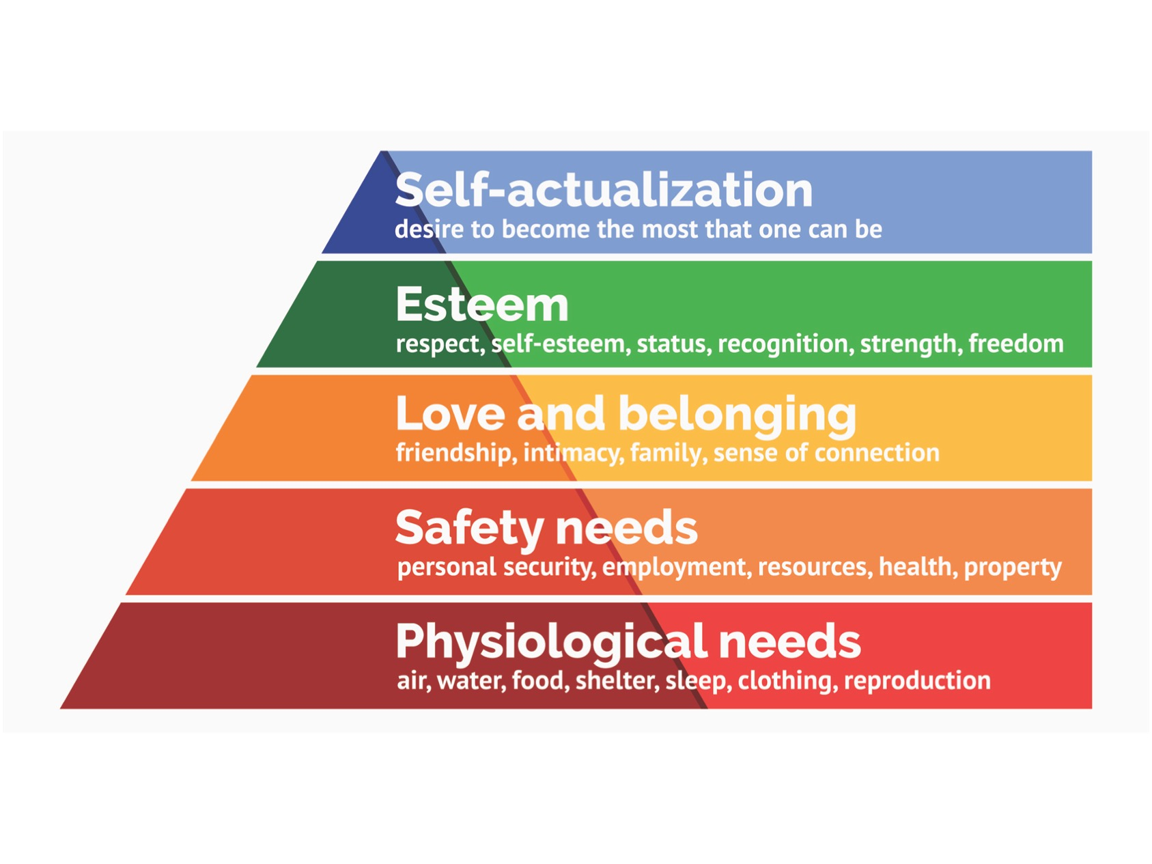
Abraham Maslow
Maslow developed Taylor’s ideas. He said that people were motivated by money but once they had enough money they were motivated by other things. He devised a hierarchy of needs.

Slide 5
Maslow said that all people have the same needs, just at different times.
He said that each person must complete each level of the hierarchy before they climb to the next level. Nobody will not be motivated by a higher level if there is an area that has not be fulfilled, i.e. you cannot be fulfilled by social needs if you are concerned about not having enough money.
According to Maslow, managers must identify the level of the hierarchy that a particular job provides and then look for ways of allowing the employees to benefit from the next level up the hierarchy. For example, workers in agriculture who work on a temporary basis, when required, will probably have physiological needs fulfilled, but security needs may be lacking. If they were offered full time jobs, they might feel more committed to the business and work more effectively.

Slide 6
Discussion Task:
Identify which of Maslow’s needs are being satisfied for each of these employees. Explain your choices.
Miguel works as a farm labourer for a rich landlord. He has a small house on the estate and is allowed to grow his own food on a piece of land next to his house. He grows enough food to feed himself and his family and is paid a small wage, which pays for the other needs of the family such as clothes, shoes and medicines.
Pierre works in a car factory on the assembly line. He works in a team of other workers welding the car body together. He is also a member of the company football team. He is well paid and his family can afford quite a few luxuries.
Anya has a degree in Business Management and professional qualifications in human resources management. She is the Human Resources Manager of a large company. She has her own office with her name of the door and is in charge of the rest of the human resources staff. She works long hours but feels it is worth it if the right employees are recruited to the company.

Slide 7
Frederick Herzberg
Herzberg’s motivation theories were based on his study of work on engineers and accountants.
According to the Herzberg, humans have two sets of needs; one is for the basic needs, which he called ’hygiene factors’, and the second is for a human being to be able to grow psychologically, which he called ‘motivators’.
He said that the hygiene factors must be satisfied; if they are not satisfied, they can act as demotivators to the worker. However, once they are satisfied, they will not act as motivators.
He also, said that the hygiene factors must be fulfilled before the motivators can begin to motivate workers.

Slide 8
Hygiene Factors | Motivators
Status | Achievement
Security | Recognition
Work conditions | Personal growth/Development
Relationship with supervisor | Advancement/Promotion
Relationship with subordinates | Work itself
Salary

Slide 9
Discussion Task:
Look at this case study.
Why do you think the workers might not be happy in their jobs?
How do you think the management might increase the motivation of their workers.
Company A employs 100 workers taking telephone orders and making calls to potential customers. The company thinks it treats its workers well. The offices they work in are well lit, warm but not too hot, the salary is similar to pay in other similar jobs, the supervisors are polite and keep checking the work of the employees. The workers are told what to do have no opportunities for promotion. There is no recognition or workers who have done well in their jobs. The management is worried because the workers do not seem to be particularly happy and have not increased their productivity. There is high labour turnover.

Slide 10
Written Task:
Write definitions of:
Labour productivity
Self-actualization
Motivation
Briefly explain the theories of:
Taylor
Maslow
Herzberg

