Slide 1
Organisational Structure

Slide 2
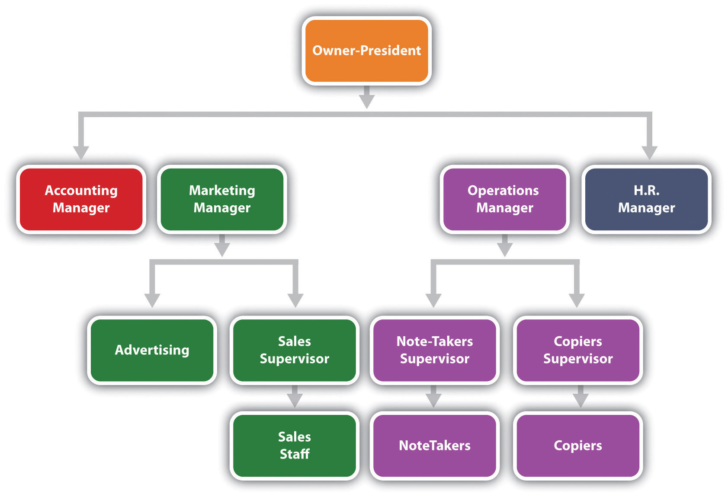
What is organizational structure?
Organizational structure is the different levels of management and responsibilities within a business.
This information is often presented in the form of an organization chart.

Slide 3
Advantages of an organization chart
The chart shows how everybody is linked together in the organization. All employees are aware of how communication works within the organization.
Everybody in the organization can clearly see who they are accountable to and who they have authority over.
It shows the links between different departments in the organization.
It gives a sense of belonging to the company

Slide 4
Terminology
Subordinates = The person working below someone else in an organization.
Chain of command = the line through which instructions and infomraiton are carried and passed within an organization.
Span of control = the number of subordinates working directly under a manager.

Slide 5
Companies can have a long chain or command with a narrow span of control, or a short chain of command with a wide span of control, i.e. they are either short and fat or tall and thin!!

Slide 6
Complete Activities 7.3 and 7.4 on pages 80 and 81 of the text book.

