Slide 1
Organisation and Management

Slide 2
The role and functions of management
As we saw last week, businesses are organized to make them more efficient.
We looked at the organizational structure and considered the span of control and chain of command.
Within these organisations there are specific roles and terms we use.
Using your text book, look up the Key Terms words and write the definitions in your book.
Key Terms:
Board of Directors
Director
Line Manager
Supervisor
Staff Manager
Functional Department
Authority

Slide 3
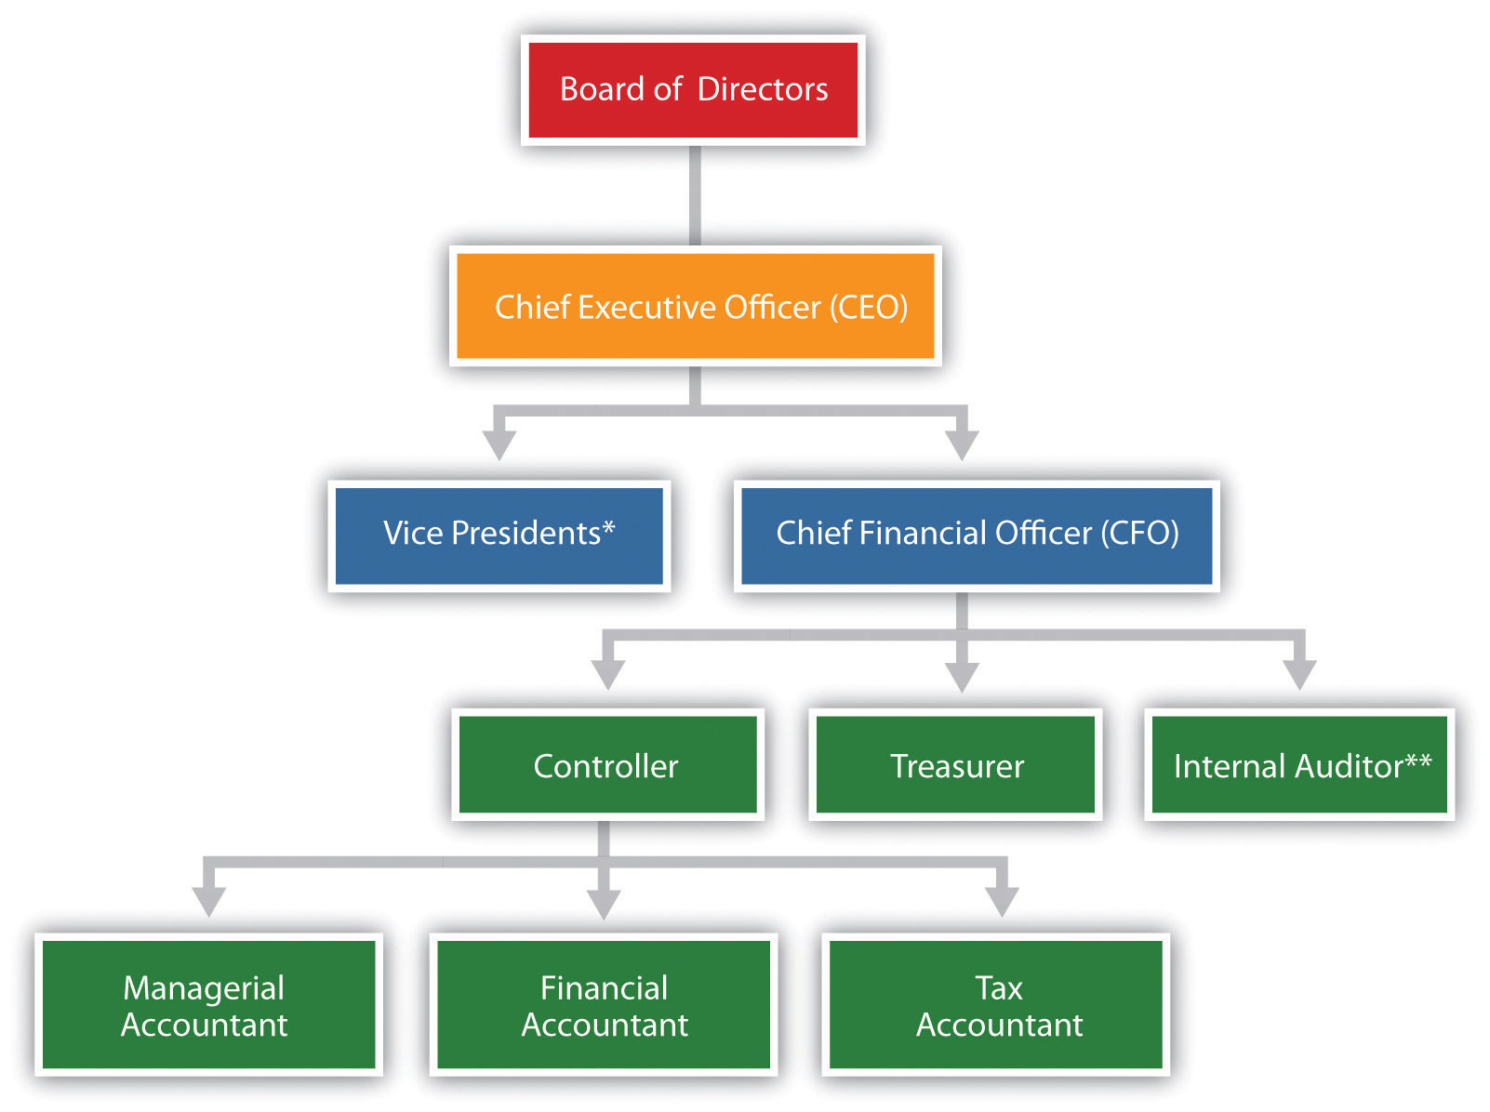
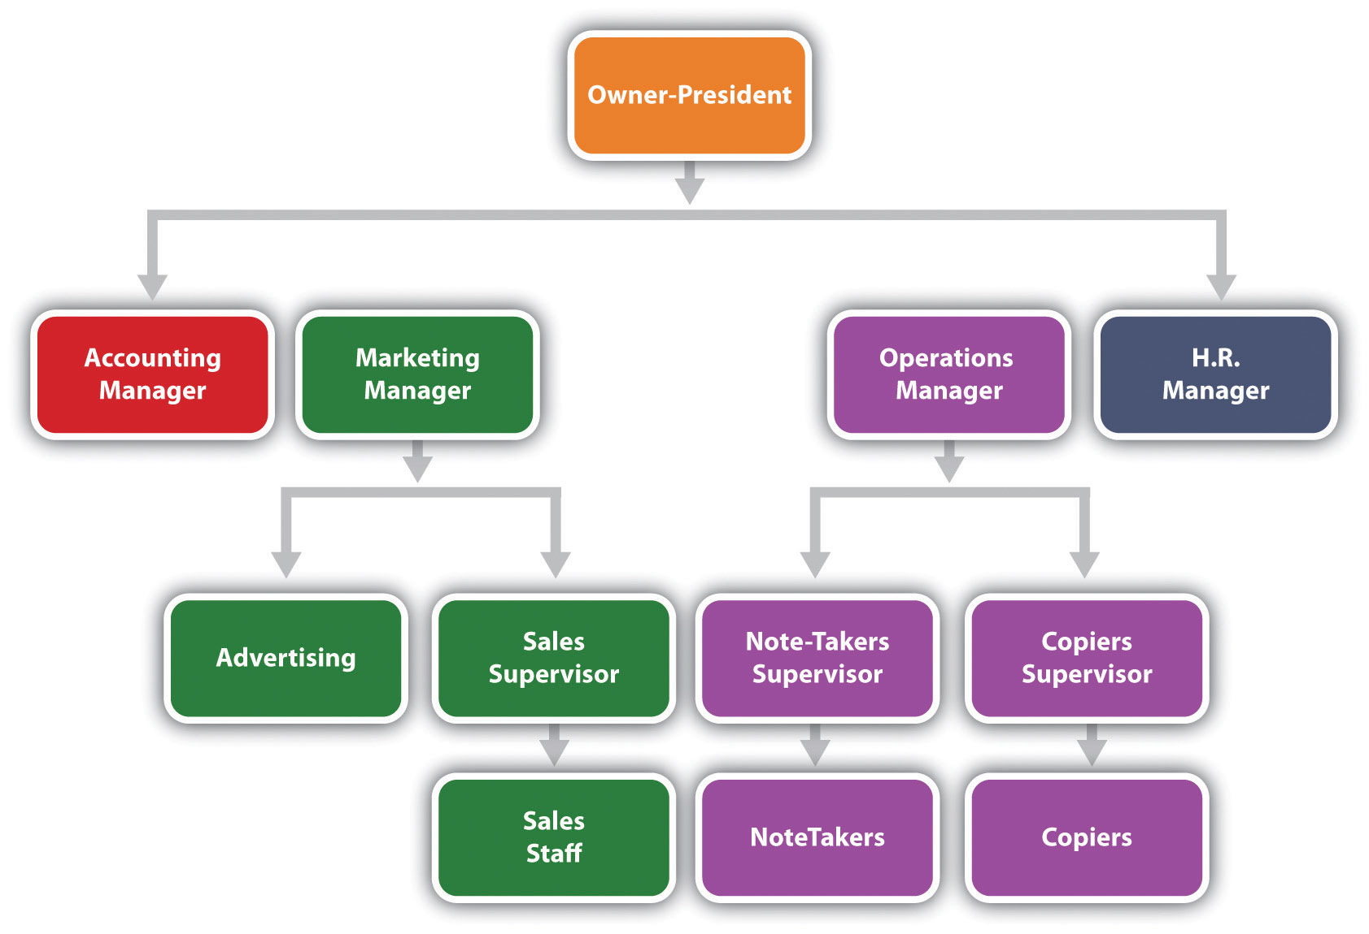

Slide 4
Role of Management
A manager is someone who has a leadership role within the organization. These people fulfil specific roles:
Planning
Organising
Co-ordinating
Commanding
Controlling
Co-ordinating
A manager will bring together the appropriate people and resources to achieve the company goals. They will help the departments work together efficiently.
Commanding
Command doesn’t mean just giving orders!
It involves instructing everyone to complete their tasks in the best way possible. It involves excellent communication.
Controlling
This involves making sure everyone is completing their tasks correctly. It does not necessarily mean being bossy or discipling people, it involves teaching people the best way to do things.
Planning
Planning involves setting up the aims and objectives of the organization and working out how to implement these objectives.
Organising
A manager will delegate the appropriate tasks and resources to ensure all tasks are completed efficiently.

Slide 5
Delegation
Delegation means passing on the authority to perform tasks to subordinates.
A reduction in direct control by supervisors and managers once tasks are done by workers.
Increasing trust or workers by supervisors and managers
Delegation must mean:
Copy the definition of delegation and the diagram into your book.

Slide 6
Gives authority to others to take
decisions and perform tasks
Makes work
more interesting
Employee development
increases job satisfaction
…………................
………….............
…………....
Delegation
…………..........
Subordinate feels trusted
if no training given
…………......
Allows managers to
give time to other issues
………….........
………….........
Some managers are
reluctant to delegate
Manager loses some
control over subordinates
Copy this diagram into your book.

Slide 7
Why is it important to have good managers?
A good manager should:
Motivate employees.
Give guidance and advice to employees they manage.
Inspire employees they manage to achieve more than they thought possible.
Manage resources effectively and keep costs under control.
Increase profitability of the business.

