Slide 1
Business Growth

Slide 2
On the mini white board, list all the ways that you can measure something.

Slide 3
How businesses are measured?
Business can be measured in terms of size or success. For the next couple of lessons we are going to look at the size of businesses.
Businesses can vary greatly in terms of size. On one hand, firms can be owned and run by a single individual. At the other extreme, some businesses employ hundreds of thousands of worker all over the world. Some firms produce output worth hundreds of dollars a year, while the biggest business sell goods valued at billions of dollars a year.

Slide 4
Why do we need a comparison?
There are many reasons we need to be able to compare the size of businesses and different groups will be looking for different things.
Investors – before deciding which business to put their savings into.
Government – often there are different tax rates for small and large businesses.
Competitors – to compare their size and importance with other firms.
Workers – to have some idea of how many people they might be working with.
Banks – to see how important a loan to the business is compared to its overall size.

Slide 5
How do we measure businesses?
Business size can be measured in a number of ways. The most common are:
The number of people employed
The value of output
The value of sales
The value of capital employed
Use page 26 in the text book to write a explanation of each of these measures of growth. Include the limitations of these.

Slide 6
How do businesses grow?
Businesses can expand in two main ways:
By internal growth – opening a bigger business or another branch. This growth is often paid for by profits from the existing business. It is often quite slow but is easier to manage than external growth.
By external growth – this involves either taking over another business or merging with another business.

Slide 7
External growth is when a business either takes over or merges with another
business.
A take over is when one business buys the whole of another a business so that it cease to exist in its own right.
A merger is when two companies come together to be come one business. They will often merge the two original names.
There are three main types of external growth”
Horizontal integration (on the same level of production)
Vertical integration (on the next or previous level of production)
Conglomerate integration (in a completely different industry_

Slide 8
Horizontal Integration
Horizontal integration is when one firm merges with or takes over another firm in the same industry at he same level of production.
Example: One nail salon buying another nail salon.ç

Slide 9
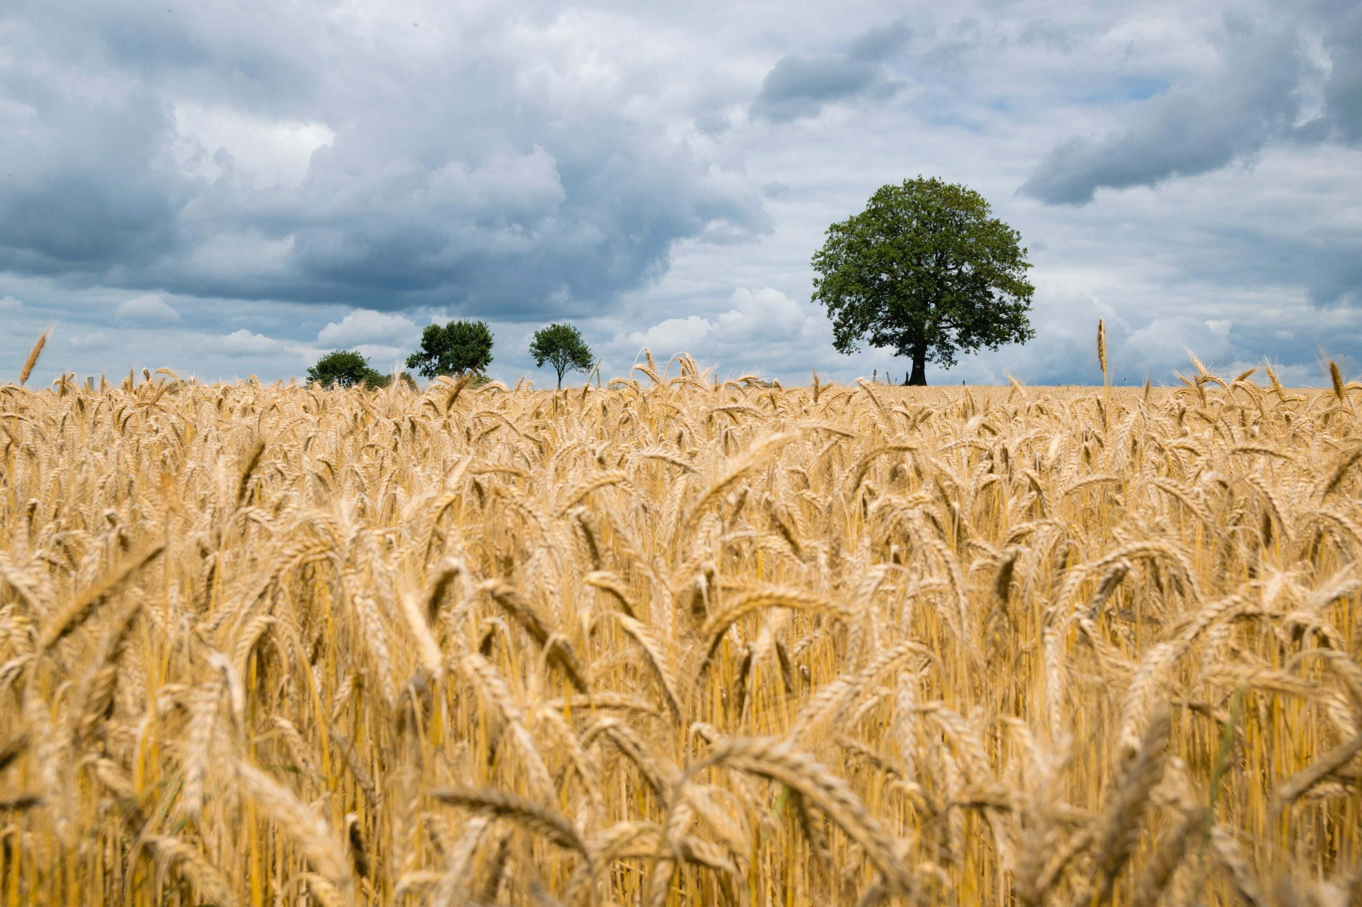
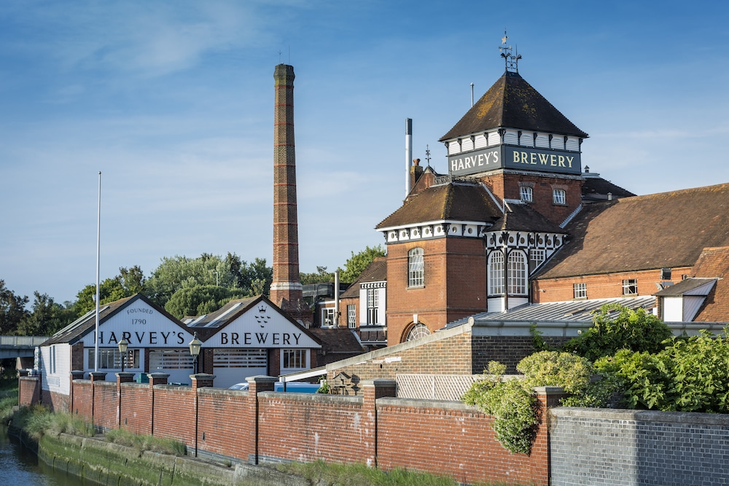
Vertical Integration
Vertical integration is when one business merges with or takes over another one in the same industry but at a different stage of production.
Vertical integration can be forward – when a business integrates with another business which is at a later stage of production (closer to the consumer) - or backward – when a business integrates with another business at an earlier stage of production (closer to the raw materials supplies).
Example: A brewery buying a farm that sells the necessary grain or buying the bars which sell the alcohol they produce.

Slide 10
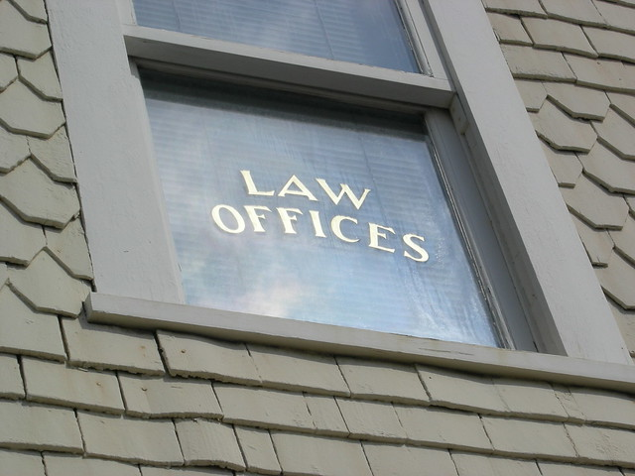
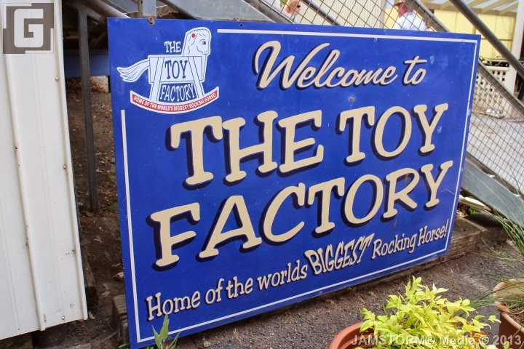
Conglomerate Integration
Conglomerate integration is when one firm merges with or takes over another firm in a completely different industry. This is also known as diversification.
Example: A law firm taking over a toy making factory.

Slide 11
Use pages 28 and 29 in the text book to take notes on the different types of integration and their benefits.

Slide 12
Why do some companies stay small?
Not all companies want to grow. Some choose to stay small. The main reasons for this is:
The type of industry the business operates in – they like to provide a personal service, e.g. a mechanic, hairdresser, etc. and they need to be small to do this. Also these types of businesses tend to be easy to set up so there is a lot of competition keeping all the businesses small.
Market size – there is a small number of customers.
Owners’ objectives – owners prefer to keep their businesses small so they can maintain control over them.
This desire to stay small can lead to specialization, which is where the business concentrates solely on what it is good at.

Slide 13
Economies and Diseconomies of Scale

Slide 14
Economies of scale are the factors that lead to a reduction in average costs as a business increases in size, i.e. they are the cost benefits of growth.
Average costs are the total costs of production divided by total output, i.e. how much is costs to produce each item. All businesses want this figure to be as low as possible.

Slide 15
There are six main economies of scale:
Purchasing economies – large companies can afford to buy in bulk and have space to store the raw materials. Also, when you buy in bulk you also often qualify for discounts. This reduces the unit cost of each item which is better for the company.
Marketing economies – large companies may be able to afford their own transportation for distributing their products. Also customers tend to be more aware of bigger companies meaning they have to do less marketing. Advertising rates stay the same however many products you sell, so the cost of marketing for bigger firms is proportionally less than that of smaller firms.
Financial economies – large firms have more access to capital than smaller firms, e.g. selling shares, or banks being more willing to lend them money.

Slide 16
Managerial economies – large firms can afford to pay for specialist managers which may improve their efficiency.
Technical economies – large firms can afford more up to date and larger machinery and technology which may make them more efficient. They can often use flow production (a production line) which means they make more products in the same amount of time.
Risk bearing economies – large firms are more likely to diversify their product lines which means they are more secure than smaller firms.
Task: Take notes on each of the economies of scale

Slide 17
Diseconomies of scale are the opposite of the economies of scale. They are the problems companies encounter when they grow too large. These are often linked to the efficiency of the company.
There are three main diseconomies of scale you need to know:
Poor communication – when the company is bigger it is difficult for there to be ‘effective communication’, i.e. communication can be slow or inaccurate which could lead to mistakes.
Lack of commitment from employees – in larger firms, employees may feel less loyalty to the company than in smaller firms and this can lead to less motivation and a lower work rate.
Weak co-ordination – As the firm is bigger it is harder for all departments to work together and this could mean decisions take longer. This means the company be less efficient overall.

