Slide 1
Workforce Planning

Slide 2
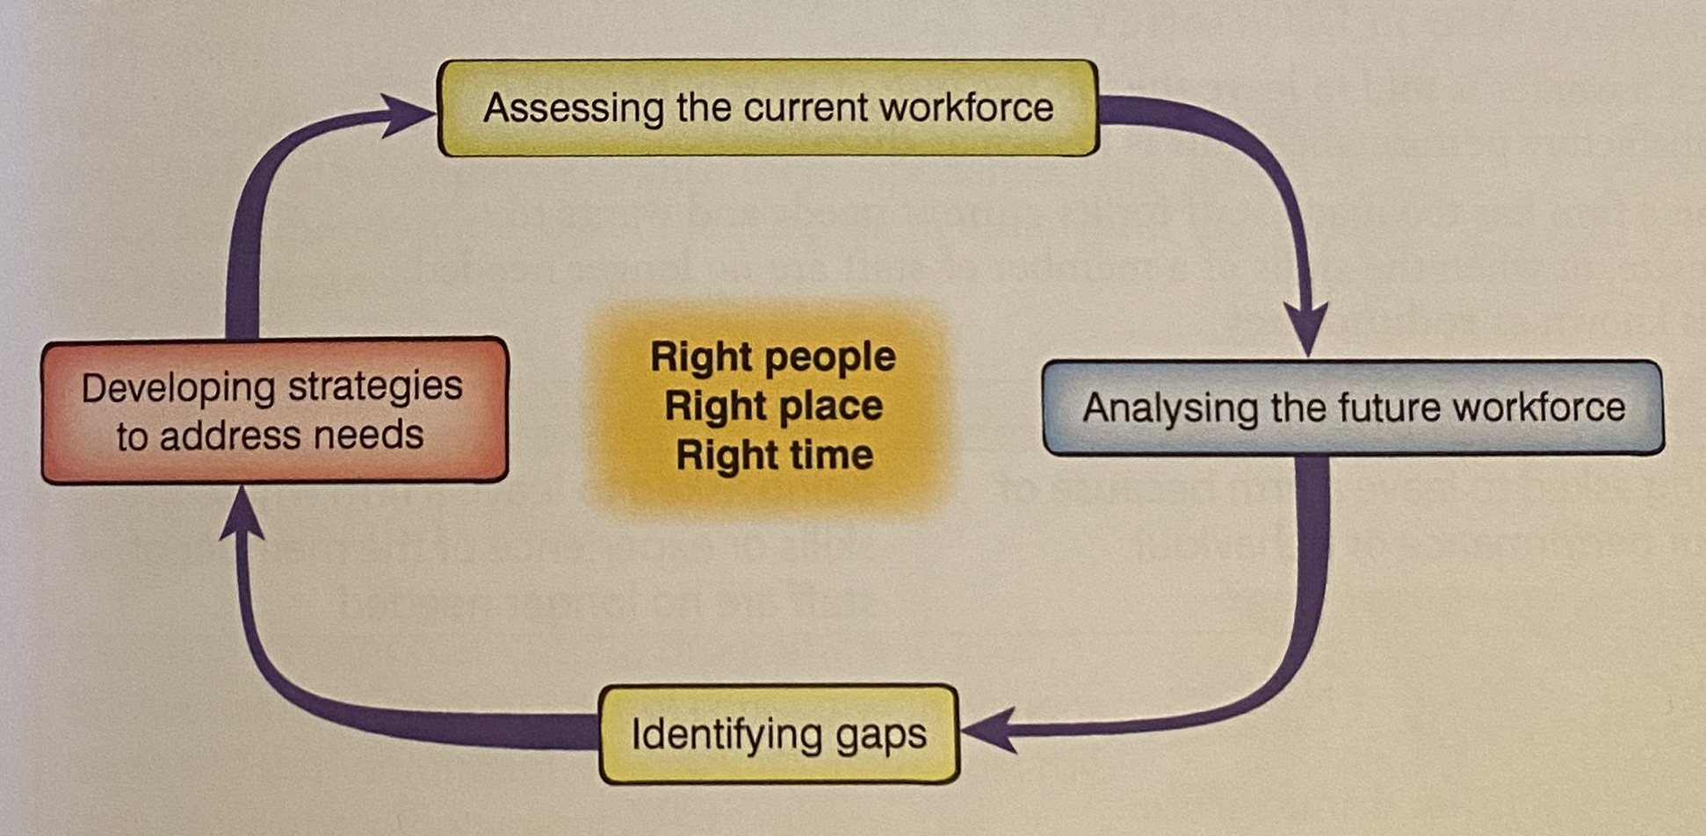
Workforce Planning
Workforce planning is establishing the workforce needed by the business for the foreseeable future in terms of the number and skills of the
In order to plan effectively, businesses need to follow this process.

Slide 3
Reasons for downsizing
Downsizing means to reduce the number of employees.
A firm may need to downsize for one of the following reasons:
A business suffering poor sales may want to decrease production and therefore needs to reduce surplus staff.
A merger between firms may result in excess staff in certain positions.
A firm may move its operations to a new part of the company or even overseas.
A business may close a branch or store.
A firm may automate production (thus reducing the need for staff.
The firm has outsourced some services.
The economy is in recession which can affect the survival of the firm and therefore they may need to reduce the number of staff.

Slide 4
Assessing the current workforce
A firm needs to know how many staff it currently has. It also needs to know what skills and experience the staff have and how old they are. Knowing the age profile of its staff enables a firms to know when staff might retire and helps them to predict employee/labour turnover.
Predict future needs
Taking into account forecasts about the state of the economy and any plans for business expansion or contraction, a firm will calculate how many staff it needs for the future. The firm may also need to consider the impact of new technology and then decide whether its current staff have the right skills for the firms future needs.
The balance of these two factors (current staffing and future needs) will determine whether the firm needs to recruit more staff, or whether they need to downsize.

Slide 5
Dismissal
Dismissal is when a worker is asked to leave the company because of poor performance or behaviour.
The main reasons for dismissal are:
Gross misconduct – examples of gross misconduct include stealing and breaking a serious company rule (such as those dealing with health and safety)
Continual underperformance – if a member of staff continually fails to perform at a satisfactory level, the firm can dismiss them. In most countries, the law requires that the member of staff is given several warnings before dismissal.
Breaking the law – the rules regarding this are quite complex, but in simple terms, if a member of staff breaks a law that is inconsistent with them performing their job, a firm has the legal right of dismissal. For example, if a delivery driver is banned from driving, he or she will no longer be able to perform the job and so can be legally dismissed.

Slide 6
Redundancy
The word redundant means surplus to requirement, this means that the company has too many staff for its needs, or too many staff of the wrong kind. For the employee, it means that they lose their job but they have not done anything wrong.
Make staff redundant saves cost in the long term but is very expensive in the short term. In most countries, staff are entitled to redundancy pay (sometimes called severance pay). Redundancy pay is usually calculated on the basis of how many years a member of staff has worked for a firm. These payments can be very costly in the short term, but they do save a firm money in the long term as they no longer have to pay the employee.
When deciding which staff to make redundant, a firm will consider things such as the employee’s skills, their experience, their length of service (and therefore the cost of making them redundant) and their overall performance.

Slide 7
Part time staff
A part time member of staff is one that works a reduced schedule compared to a full time member of staff. The number of hours a part time member of staff will work will depend on the number of hours a full staff member of staff is expected to work.
Advantages
Workers are more flexible
They can work at the busiest times.
It is easier for workers with families or other commitments.
It will be cheaper when the business isn’t doing as well.
Disadvantages
May be complicated to supervise more members of staff.
The employee may not be as loyal to the company.
There could be additional costs related to recruitment and training.

Slide 8
Full time staff
It is generally accepted that full time staff usually work 35 hours or more.
Advantages
Workers may feel more secure and motivated with a full time job.
It is easier to manage a smaller amount of full time staff than lots of part time staff.
Lower recruitment costs
Disadvantages
There is less flexibility with staff.
You have to pay staff even when there is not enough money in the business to do this.

