Slide 1
Factors of Production and Opportunity Costs

Slide 2
Needs and Wants
What do you need to live your life?
In your books, list all the things that you think you need to live your life.

Slide 3
Needs and Wants
What do you need to live your life?
In economic terms, a need is something that you need to survive but have to buy.
The five economic needs are:
Food
Water
Warmth
Shelter
Clothing
We know that oxygen is a need but you don’t need to buy it!!
Anything else that is on your list is classed as a want by economists.

Slide 4
The Economic Problem
Example:
The Government of a small country is worried about large numbers of people who cannot afford the basic needs of life. Even those citizens with more money are always complaining that the country is not producing enough of these luxuries that they want to buy. The Government decides to ‘solve’ these problems by printing more bank notes doubling everyone’s incomes.
Has the government solved the economic problem of the country? Are there now more goods for the people to buy? More houses? More schools? More cars? Improved standing of living for the population?
The answer to these questions is ‘No’. Printing more money does not produce more goods and services. It will just lead to prices rising so more goods cannot be afforded – you just pay more for the same amount of goods.

Slide 5
The Economic Problem
Most people would say that the basic economic problem is a lack of money, but money is not the answer to the problem!
The real problem is that we have too many wants in this world and not enough resources. This creates scarcity.
Unlimited wants
+
Limited resources
=
Scarcity
Scarcity creates demand and supply for products and resources and can affect the prices of these things.

Slide 6
Factors of Production
All businesses need Factors of Production, this is what we call the resources businesses need to operate. There are four factors of production:
Land | All natural resources
Labour | All human physical and mental effort
Capital | All man-made resources (this is includes money)
Enterprise | All risk-taking, innovation and organisation

Slide 7
Factors of Production
In your books copy the following diagram:
Inputs
(Resources/
Factors of Production)
Outputs
(Goods and services)
The Business
Give examples of resources your company needs
Write what outputs your company is producing.

Slide 8
Quiz
Factory building
Coal
Tractor
Timber
Teacher
Owner of a small shop
Accountant
Shareholder in Apple
Delivery driver
Paper

Slide 9
Opportunity Cost
Everyday we make choices. It is not possible to have everything!
All choices involve us giving up something.
We do have the resources to satisfy all our wants so we have to make the choice.
The thing we choose to give up is called the opportunity cost.
By choosing one thing we have lost (been cost) the opportunity to have another item.
For example, if you go to the gas station with $2 you can choose between a drink and a candy bar as you can only afford one. If you choose the drink, the ‘cost’ is the drink.
Even when you are not choosing between two items, there is still and opportunity cost. You are giving up the opportunity to buy something else with the money so the opportunity cost is your freedom to use that money again.

Slide 10
Revision summary: the economic problem
Labour
Capital
Land
Enterprise
Limited resources
ECONOMIC PROBLEM
Unlimited wants
scarcity
choice is necessary
Leads to opportunity cost
Stick the copy of this summary in your book.

Slide 11
Specialisation
As we know factors of production are in limited supply, therefore it is important we use the resources in the most efficient way possible.
In the ‘olden days’, most products were made by one person or by a small team, who started, finished and sold the product.
Nowadays, most workers specialize in one skill and most business specialize in one product. This is called specialization.
Some countries also specialize in specific industries, e.g. Cayman with banking and tourism.

Slide 12
Examples of Specialisation
Employee:
A pastry chef who only makes the desserts and cakes for a restaurant.
A mortgage adviser for a bank.
Region:
The Champagne region in France specializes in …. Champagne!
The Santo region in Brazil specializes in coffee production.
Country:
Saudi Arabia specializes in extracting oil.
Japan specializes in technology and computing.
Business:
Audi specializes in making cars.
Nestle specializes in chocolate production.
And the Cayman Islands specializes in banking and tourism!

Slide 13
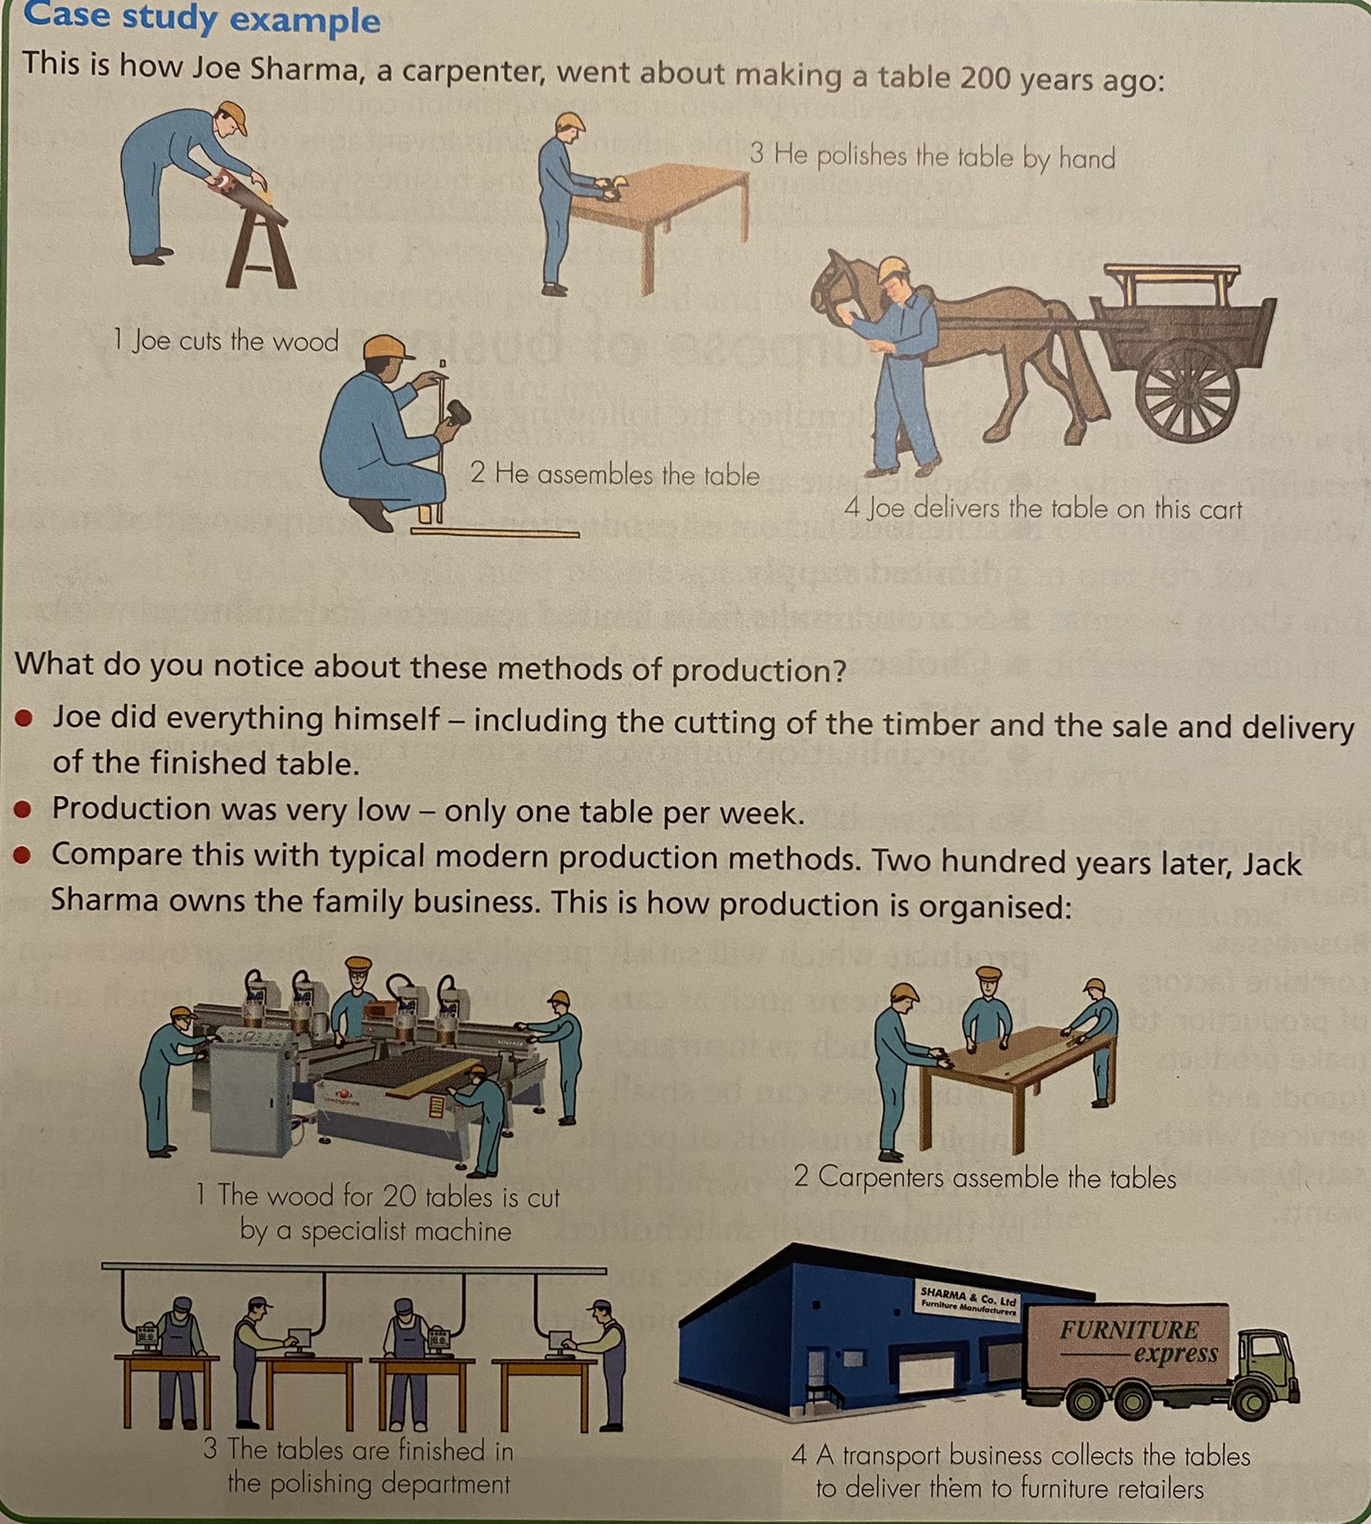
Division of Labour
Jack Sharma is using the principles of specialization and division of labour. He is dividing up the making of tables into different jobs and making each worker a specialist at just one task.

Slide 14
Division of Labour
Division of labour has advantages and disadvantages:
Advantages | Disadvantages
Workers are trained in one task and specialize in this – this increases efficiency and output. | Workers can become bored doing just one job – efficiency might fall.
Less time is wasted moving from one workbench to another. | If one worker is absent and no one else can do the job, production might be stopped.

Slide 15
Key Terms
Term | Definition
Need | Something that is essential for living.
Want | A good or service which people would like to have but is not essential for living. People’s wants are unlimited.
Economic Problem | That there exists unlimited wants but limited resources to produce the goods and services to satisfy those wants. This creates scarcity.
Factors of Production | These are the resources needed to produce goods or services. There are four factors of production and they are in limited supply.
Scarcity | The lack of sufficient products to fulfil the total wants of the population.
Opportunity Cost | This is the next best alternative given up by choosing another item.
Specialisation | This occurs when people and businesses concentrate on what they are best at.
Division of Labour | This is when the production process is split up into different tasks and each worker performs one of these tasks. It is a form of specialization.

Slide 16
Activity
Gowri plans to start up her own business using her own savings. She wants to produce fashion clothes for women. She is a very good clothes designer but she does not like stitching clothes together. Two friends have offered to help Gowri. Abha is an experienced material cutter – she can cut lengths of material for clothes with very little wastage. Aditi is quick at sewing.
What is meant by ‘business’? [2 marks]
Identify two factors of production that Gowri will need for her new business. [2 marks]
Identify and explain two possible opportunity costs that Gowri may have from her decision to start her own business. [4 marks]
Identify and explain one advantage and one disadvantage to Gowri’s business of using division of labour in making clothes. [6 marks]
Do you think that Gowri’s business will be able to sell all of the clothes that it makes? Justify your answer. [6 marks]

