Slide 1
Location

Slide 2
It is essential to choose the right location for your business. However, choosing the right location for a business depends entirely on the type of business in question. Most businesses will want to stay close to their market, whether they operate on a local or a global scale. The type of business activity – for example, whether the company manufactures a product or provides a service – is also important, as businesses requirements vary when choosing the right location.

Slide 3
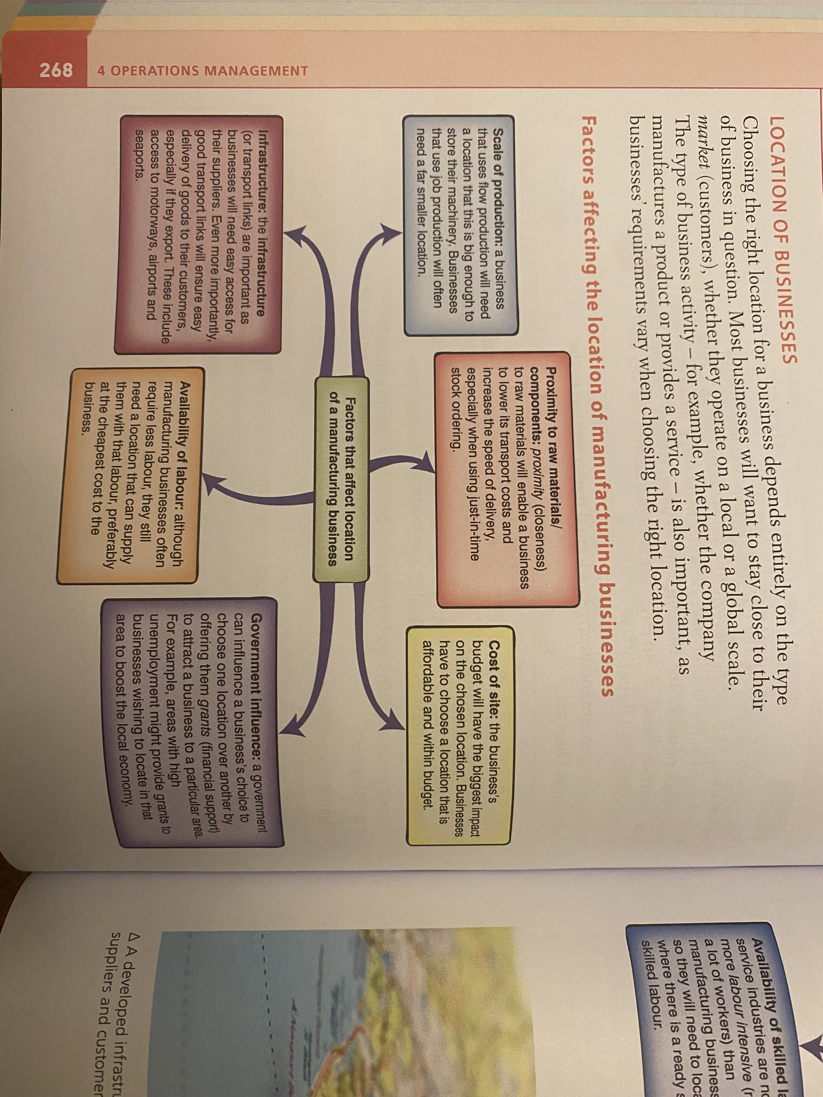

Slide 4
Task about manufacturing industries
B & B Plc manufactures food products. It wants to set up a factory to make a new ice cream. The new ice cream uses fresh ingredients – mainly freshly picked fruit – to maintain the fruits’ flavour. The fruit used comes from one particular region of the country. This region is quite a long way away from the main cities where most of the country’s population lives.
The production process is mainly automated and requires only a few skilled workers to supervise the equipment. It uses a lot of water in the mixture and also a lot of water to wash out the machinery every day to keep it clean.
The new ice cream is sold to domestic customers through supermarkets and other food stores. It is not sold abroad.
Which factors affecting the location of manufacturing plants will be most important to this businesses when deciding where to locate? Explain why you think they will be important.
Which do you think will be the most important factor and why?

Slide 6
Task about service industries
For each of the services listed below:
Choose four factors that you think are likely to affect its location.
Explain how you think each factor will influence the location decision of:
Electrician (sole trader) serving domestic customers.
Computer software firm which writes computer games that are sold all over the world.
Small firm that trains people to scuba-dive and hires out scuba-diving equipment.

Slide 7
Final task!
MT Furniture Limited wants to expand. Presently it is located in a small factory in the old part of the city. New markets are opening up abroad and MT has experienced a steady increase in its sales for the last five years. There is no room to build onto the existing factory and none of the adjacent factories are for sale. The business has been forced to look for another site if it wants to grow.
As more and more of its sales are exported, it is considering whether to build a factory abroad or whether to build a larger factory in its home country. The following information has been gathered about two sites, one near MT’s existing factory and one abroad in the country where most of the MT’s products are exported.

Slide 8
 | Site A – on the outskirts of the city near to existing factory in home country | Site B – in the main export market overseas
Market | Large local market | Large export market and growing
Communications | Good communications – main roads connect to all parts of the country and the main port, which is several miles away. | Good communications – main roads connect to all parts of the country and ports are very close to the site.
Raw materials/components | Raw materials and components are close to the site – easily available. | Raw materials and components are not close to the site – not easily available – some will need to be imported.
Wage rates | High | Low – labour is very cheap
Skilled labour | Skilled workers employed at the present site – not far from this site. Also, additional skilled workers are available in the area. | Very few skilled workers are available.
Unemployment | Low | High
Rents/land taxes | High | Low
Government grants | No grants available. | Grants paid towards capital investment when a new company is setting up in their country.

Slide 9
Read the case study and answer the questions:
Study the information provided and then write a report to the Board of Directors of MT Furniture Limited advising them of the advantages and disadvantages of each of the sites. Include a recommendation of which you think is the best site to choose. Remember to give reasons for your choice.

