Slide 1
Training

Slide 2
Training your employees correctly is one of the most important things a business can do. Effectively trained staff may increase the efficiency of the company and therefore increase the profits of the company.
Training is used to achieve a combination of the following:
increase skills
Increase knowledge
Change people’s attitudes/raise awareness.
There are three types of training:
Induction training
On-the-job training
Off-the job training

Slide 3
Induction Training
Induction training is an introduction given to a new employee, explaining the firm’s activities, customs and procedures and introducing them to the other employees.
When a new employee starts they will spend some time being introduced to all areas of the company, this can be as short as an hour or as long as over a week, it will depend on the type of company and the type of job being done.

Slide 4
Advantages
It helps a new employee settle into their job more quickly which means they will be productive faster.
It may be a legal requirement to cover things like Health and Safety rules.
It means workers are less likely to make mistakes which means less costs for the company.
Disadvantages
It is time consuming and people who are doing the training cannot continue with their regular job.
It means wages are paid to the new employee but they are not actually doing any work.
It delays the start of the employee commencing their job.

Slide 5
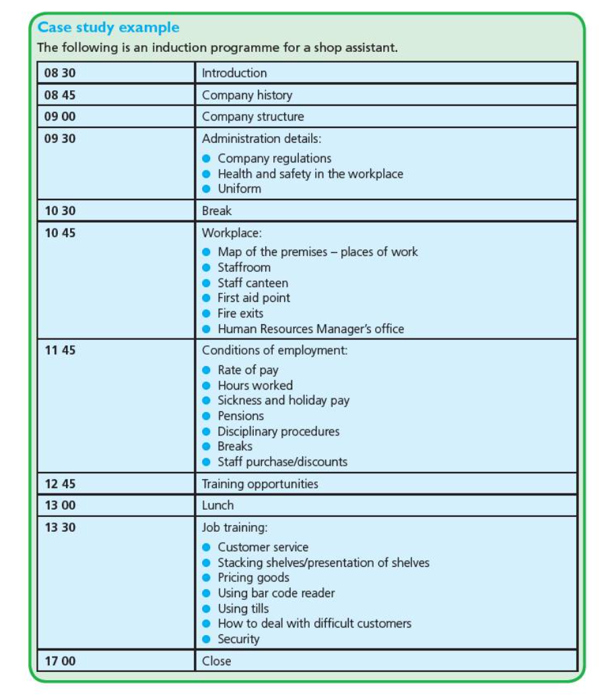

Slide 6
On-the-job Training
This is where a person is trained by watching a more experienced worker doing the job. They are shown what to do. This method of training is only suitable for unskilled and semi-skilled jobs.

Slide 7
Advantages
Individual tuition is given and it is in the workplace so the employee does not need to be sent away (travel costs are expensive).
It ensures there is some production from the worker whilst they are training.
It usually costs less than off-the-job training.
It is training to the specific needs of the business.
Disadvantages
The trainer will not be as productive as usual because they are showing the trainee what to do instead of getting on with their job.
The trainer may have bad habits and they may pass these on to the trainee.
It may not necessarily be recognized as a training qualifications outside the business.

Slide 8
Off-the-job Training
This is where the worker goes away from the place where they work. This may be in a different part of the building or it may be a different place altogether, such as a college or specialist training centre. The techniques used to train workers are more varied and can involve more complex tasks. Off-the-job training often involves classroom learning, using lecture, role play, case studies or computer simulations.

Slide 9
Advantages
A broad range of skills can be taught using these techniques.
If these courses are taught in the evening after work, they are far cheaper for the business because the employee will still carry out their normal duties during the day.
The business will only need to pay for the course and it will not also lose the output of the employee.
Employees may be taught a variety of skills, they become multi-skilled and this makes them more versatile – they can be moved around the company when the need arises.
It often uses expert trainers who have up to date knowledge of business practices.
Disadvantages
Cost are high.
If it takes place during the working day it means wages are paid but no work is being done by the worker.
The additional qualifications means it is easier for the employee to leave and find another job.
The skills may not be specific to the workplace.

Slide 10
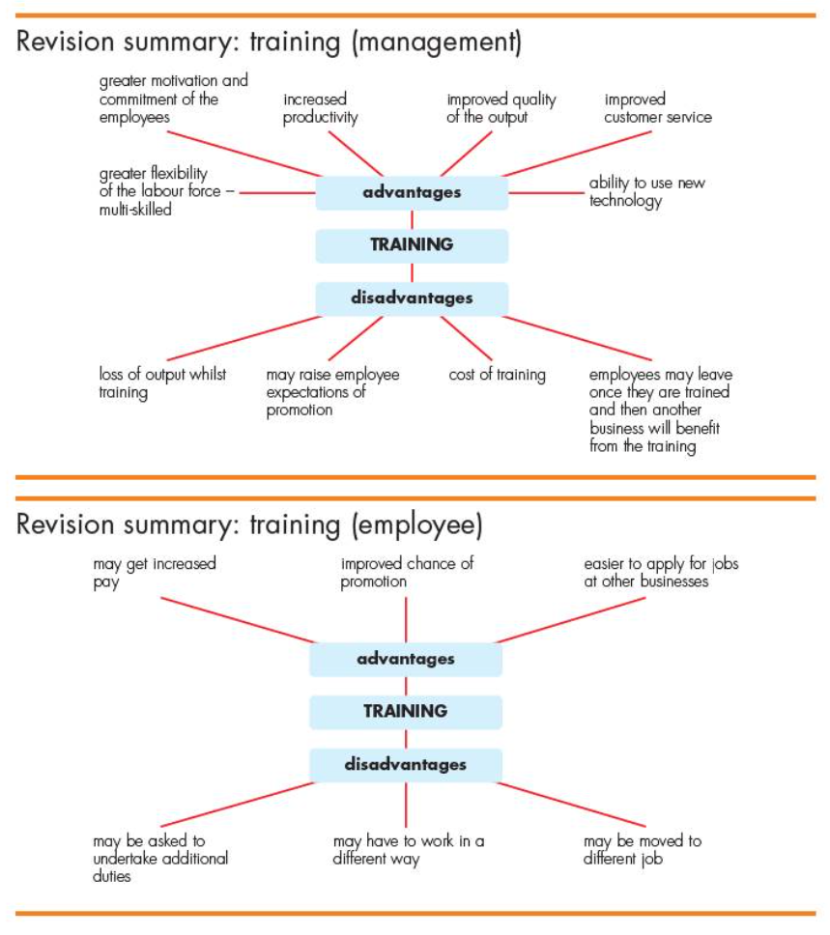

Slide 11
Task:

