Slide 1
Sectors of the economy

Slide 2
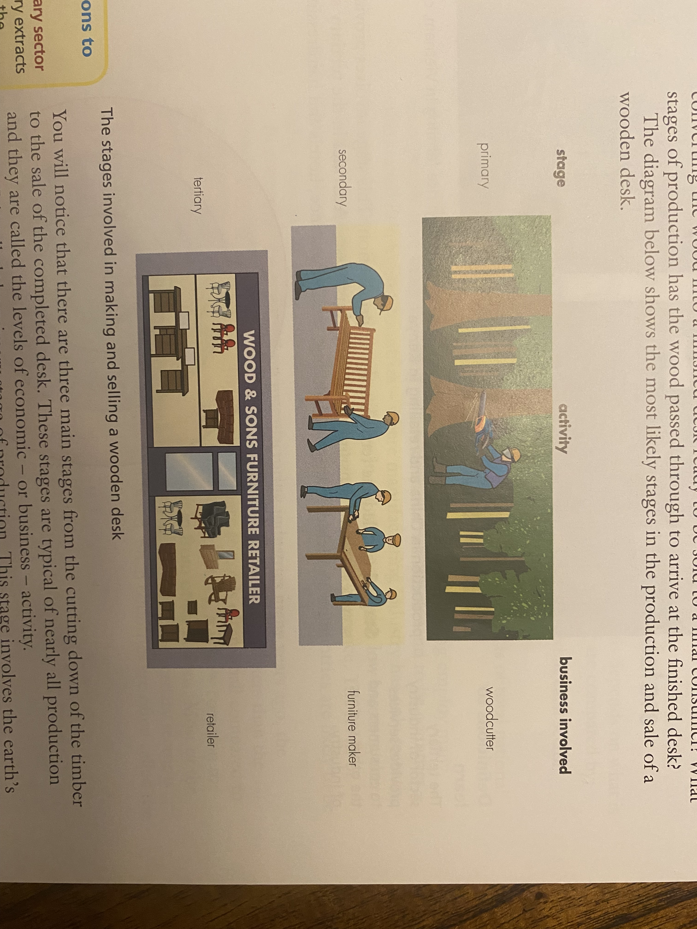

Slide 3
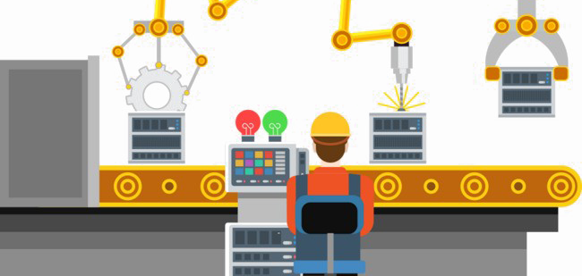
On the previous slide you will see there is three main stages from the cutting down of the timber to the sale of the completed desk. These stages are typical of nearly all production and they are called the levels of economic – or business - activity.
Stage 1 is called the primary stage of production. This stage involves the earth’s natural resources. Activities in the primary sector of industry include farming, fishing, forestry and the extraction of natural materials, such as oil and copper ore.
Stage 2 is called the secondary stage of production. This stage involves taking the materials and resources provided by the primary sector and converting them into manufactured or processed goods. Activities in the secondary sector of industry include building and construction, aircraft and car manufacturing, computer assembly, bread making.
Stage 3 is called the tertiary stage of production. This stage involves providing services to both consumers and other businesses. Activities in the tertiary sector of industry include transport, banking, retail, insurance, hotels and hairdressing.

Slide 4
Task:
Business | Primary | Secondary | Tertiary
Insurance
Forestry
Coal mining
Computer assembly
Realtor
Bakery
Car showroom

Slide 5
Relative importance of economic sectors
Usually the three sectors of the economy are compared by:
Percentage of the country’s total number of workers employed in each sector
Or
Value of output of goods and services and the proportion this is of total national output
What is the biggest sector in Cayman?

Slide 6
Changes in sector importance
In the UK and other developed economies there has been a decline in the importance of manufacturing industry – or the secondary sector – since the 1970s. The tertiary sector in the UK now employs well over 70% of all workers. Many workers who have lost jobs as factories have closed have found it difficult to obtain work in the service industries. The decline in the manufacturing or secondary of industry is called de-industrialization.
There are several reasons for changes in the relative importance of the three sectors over time:
Sources of some primary products, such as timber, oil and gas, become depleted.
Most developed economies are losing competitiveness in manufacturing to the newly industrialised countries such as Brazil, India and China.
As a country’s total wealth increases and living standards rise, consumers tend to spend a higher proportion of their incomes on services such as travel and restaurants than on manufactured products produced from primary products.

